Slide 1
Discrete Mathematical Structures And Combinatorics(CS241AT)
4th Semester
Department of AIML
Faculty: Dr.Vijayalakshmi.M.N
UNIT-2

Slide 2
Logic is science of reasoning. It provides rules and techniques for determining whether a reasoning is valid or not.

Slide 3
Basic connectives and truth tables
Basic connectives and truth tables
statement (proposition): A declarative sentence that is either true or false--but not both.
Eg. Margaret Mitchell wrote Gone with the Wind.
2+3=5.
not statements: Exclamations or command
What a beautiful morning!
Get up and do your exercises.
X+7=10

Slide 4
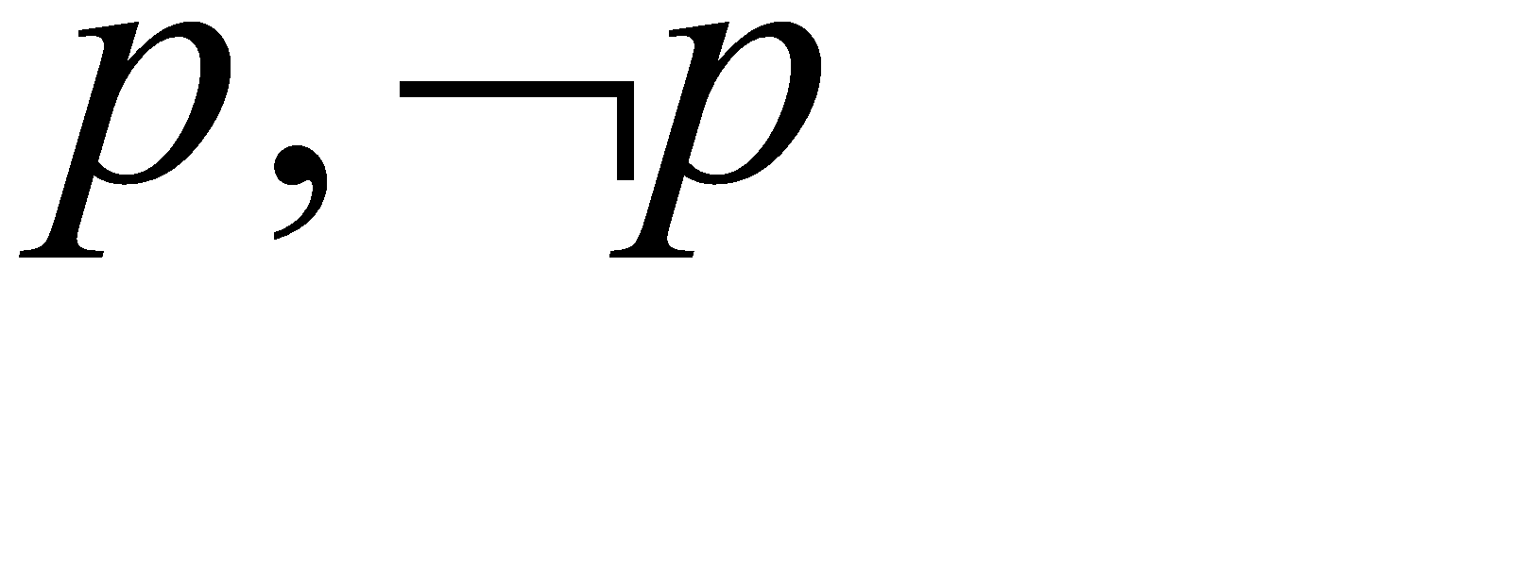
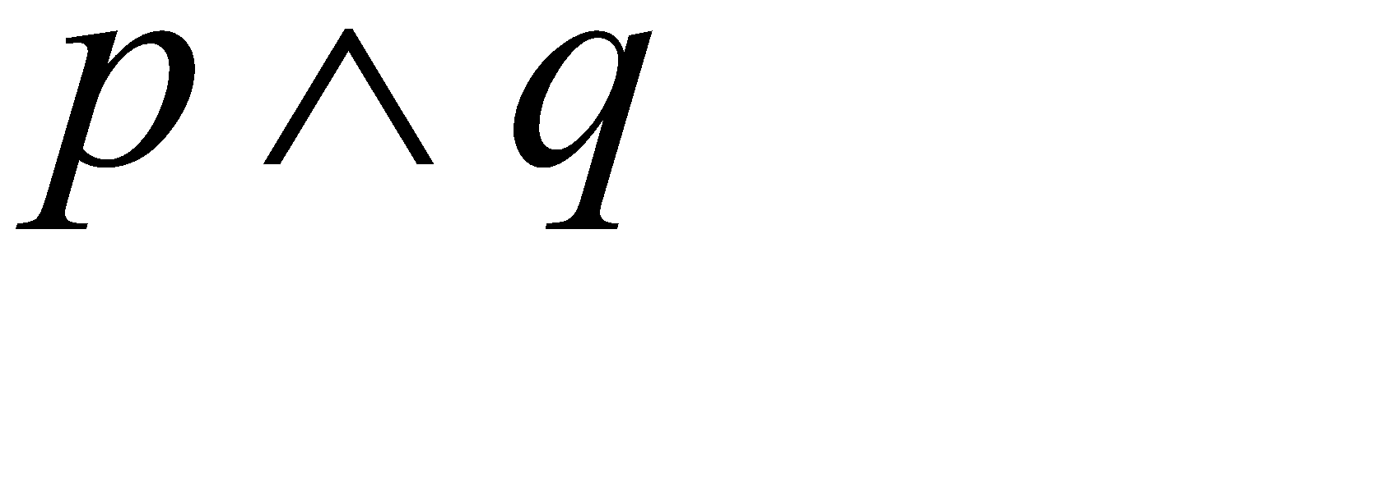
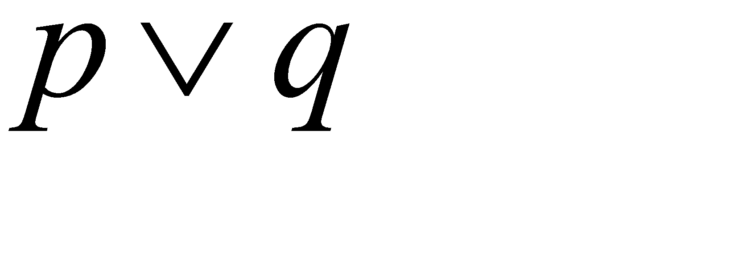
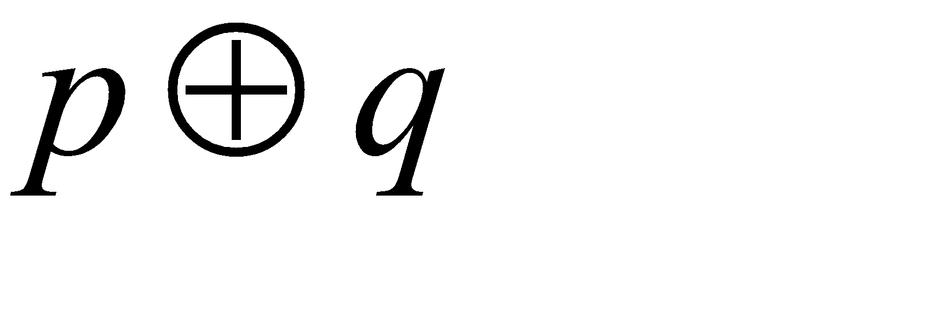
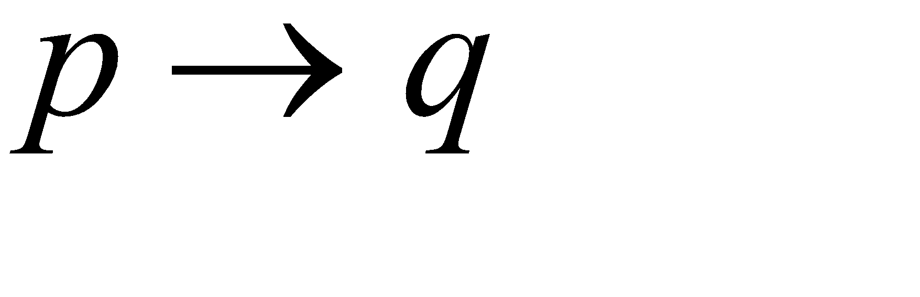
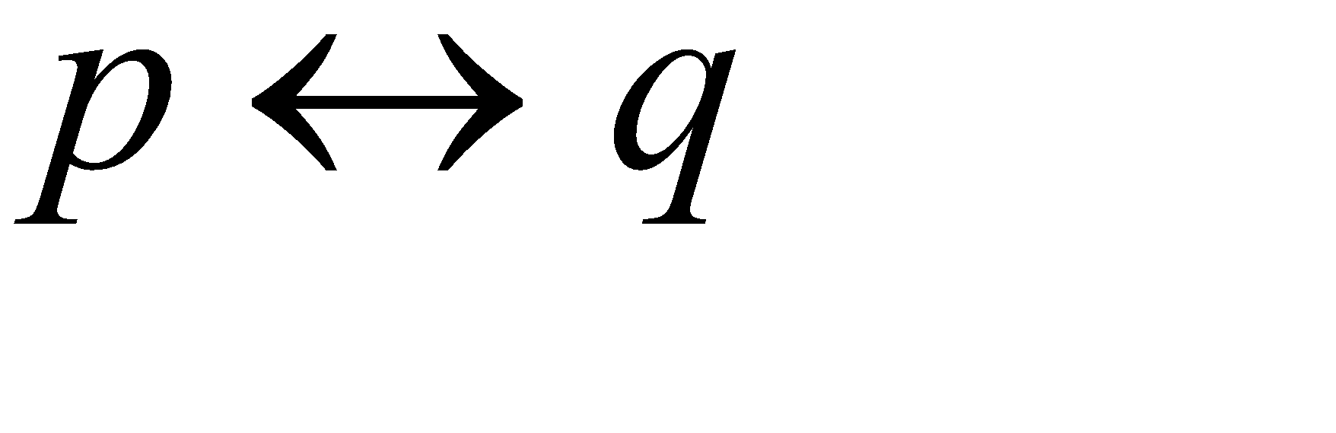
Basic connectives and truth tables
Primitive statement- A statement which cannot be further broken into
simpler propositions
Compound statements- combined from primitive statements by logical connectives or by negation ( )
logical connectives:
(a) conjunction (AND):
(b) disjunction(inclusive OR):
(c) exclusive or:
(d) implication: (if p then q)
(e) biconditional: (p if and only if q, or p iff q)

Slide 5
Basic connectives and truth tables
"The number x is an integer." is not a statement because its truth value cannot be determined until a numerical value is assigned for x.

Slide 6
Ex: 1)
s : Phyllis goes out for a walk
t : The moon is out
u : it is snowing
Then
(t^ ¬u) → s
if the moon is out and it is not snowing then, Phyllis goes out for a walk
b) t → (¬u → s)
if the moon is out then, if it is not snowing then Phyllis goes out for a walk
c) ¬(s ↔ (u ꓦ t))
if it is not the case that Phyllis goes out for a walk iff it is snowing or the moon is out
d) “Phyllis goes out for a walk iff the moon is out”
s ↔ t
e) “ if it is snowing and the moon is not out then, Phyllis will not go out for a walk”
(¬u ^ t ) → s
f) “ It is snowing but Phyllis will still go out for a walk”
u ^ s
NOTE: but ⇔ AND

Slide 7
g) If I weigh more than 120 pounds, then I shall enroll in an exercise class.
Ans: p: I weigh more than 120 pounds
q: I shall enroll in an exercise class
p → q

Slide 8
Basic connectives and truth tables
Truth Tables
p q
0 0 0 0 0 1 1
0 1 0 1 1 1 0
1 0 0 1 1 0 0
1 1 1 1 0 1 1

Slide 9
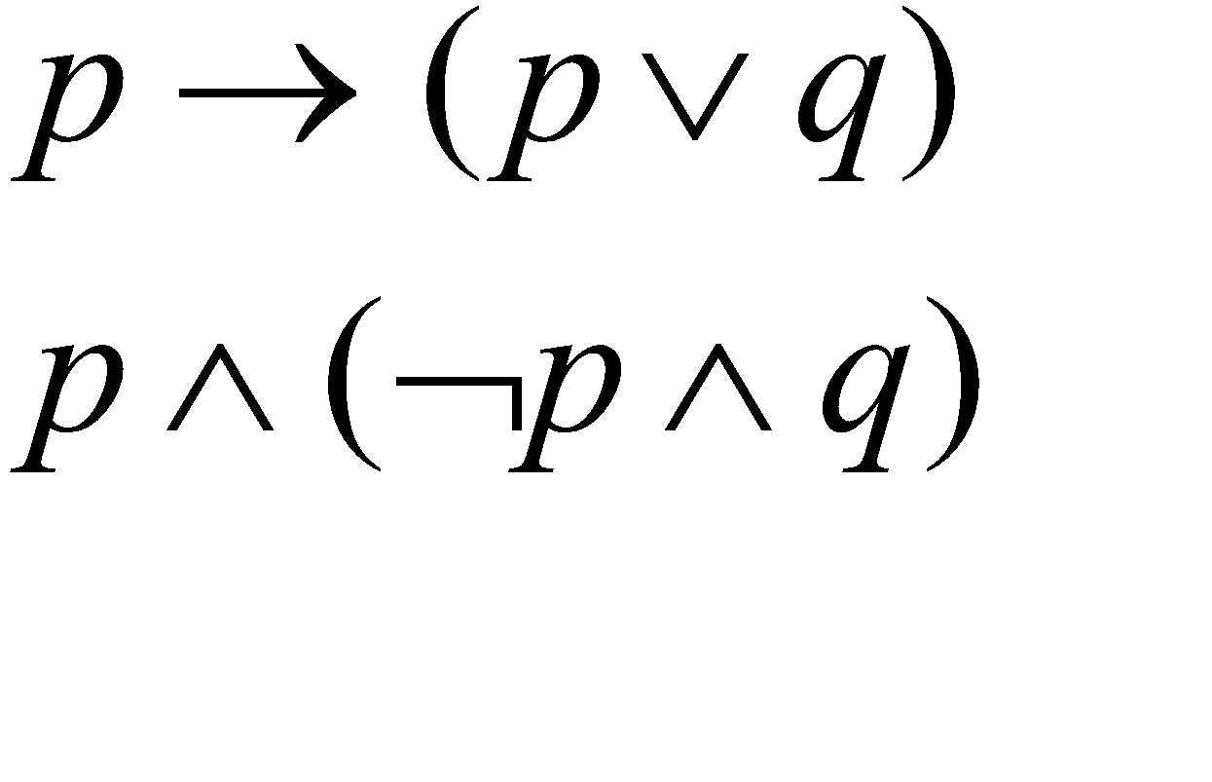
Basic connectives and truth tables
Def. 2.1. A compound statement is called a tautology(T₀) if it is true for all truth value assignments for its component statements.
If a compound statement is false for all such assignments, then it is called a contradiction(F₀).
If a compound statement is true for some assignments, and false for some assignments, then it is called a contingency.
Tautology and implication are used to describe valid argument and will help to prove mathematical theorems.
: Tautology
: Contradiction

Slide 10
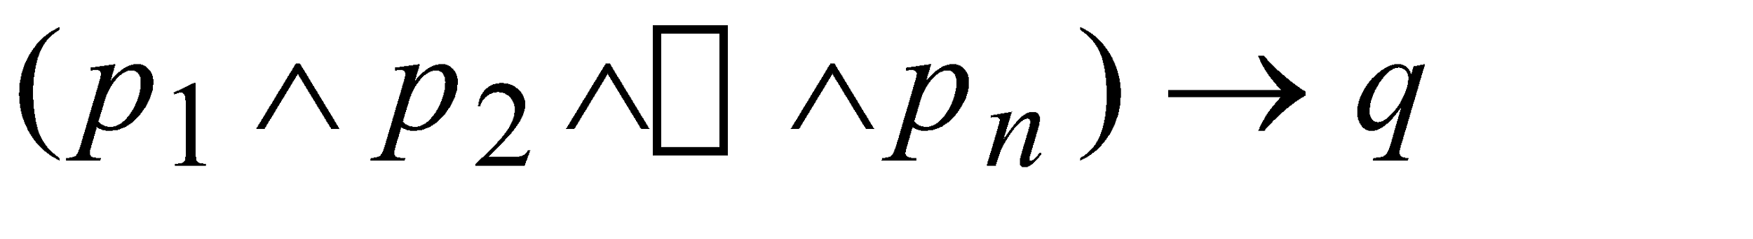
Basic connectives and truth tables
an argument:
premises
conclusion
In general, an argument starts with a list of given statements called premises and a statement called conclusion of the argument.
We examine the premises p₁,p₂,………. p_{n} & try to show that conclusion q follows logically from these given statements. That is we try to show if each of p_{i}≤i≤n is true, then q is true.
If any one of p₁,p₂,………. p_{n} is false, then irrespective of q,
the implication is true.
Consequently, if we start with the premises p₁,p₂,………. p_{n} each with 1 and find that under these circumstances q also has value 1, then the implication is a tautology and we have a valid argument.
p | q | p→q
0 | 0 | 1
0 | 1 | 1
1 | 0 | 0
1 | 1 | 1

Slide 11
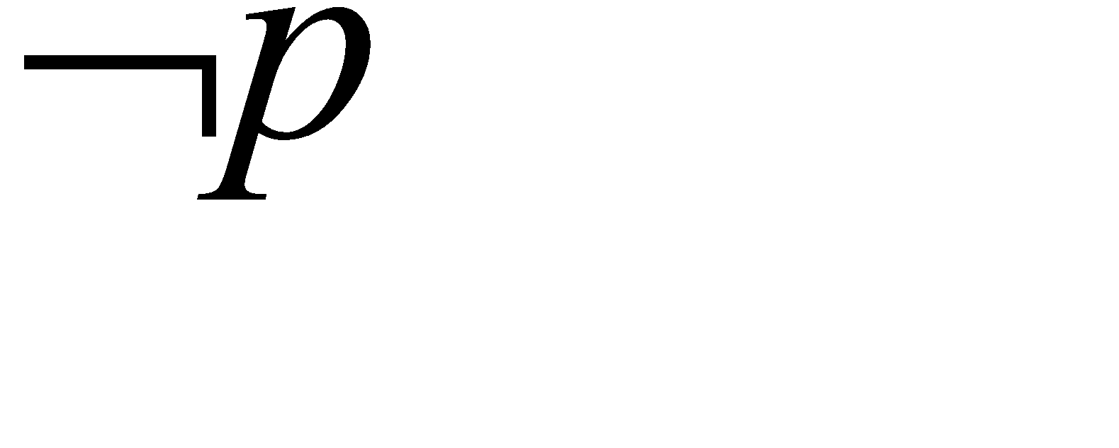
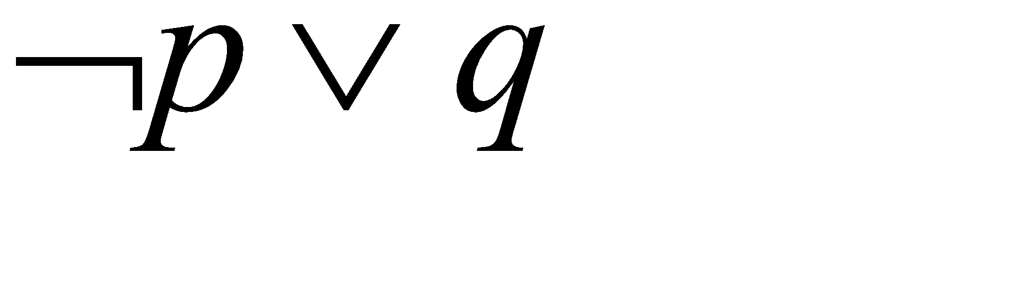
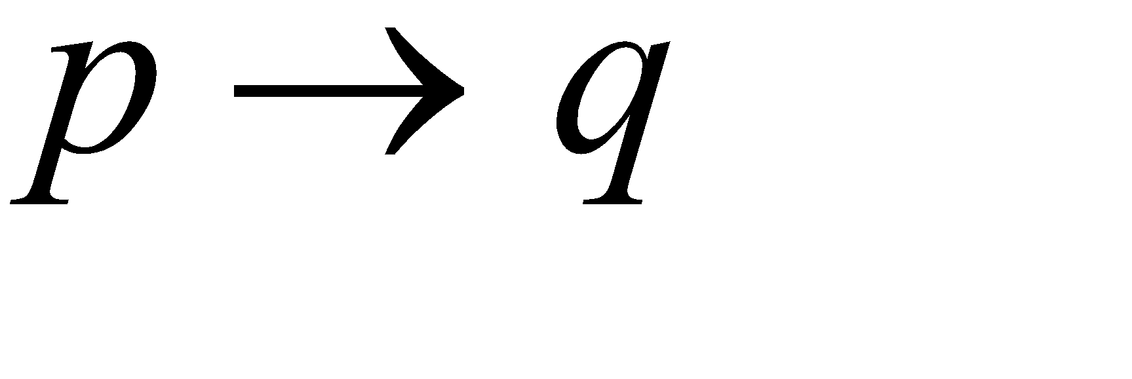
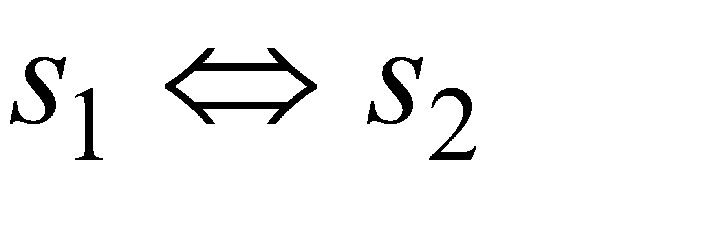
Logical Equivalence:
The Laws of Logic
Ex. 2.7
p
q
0
0
1
1
0
1
0
1
1
1
0
0
1
1
0
1
1
1
0
1
Def 2.2 . logically equivalent
Two statements s₁ and s₂ are equivalent when s₁ is true iff s₂ is true and when s₁ is false iff s₂ is also false.

Slide 12
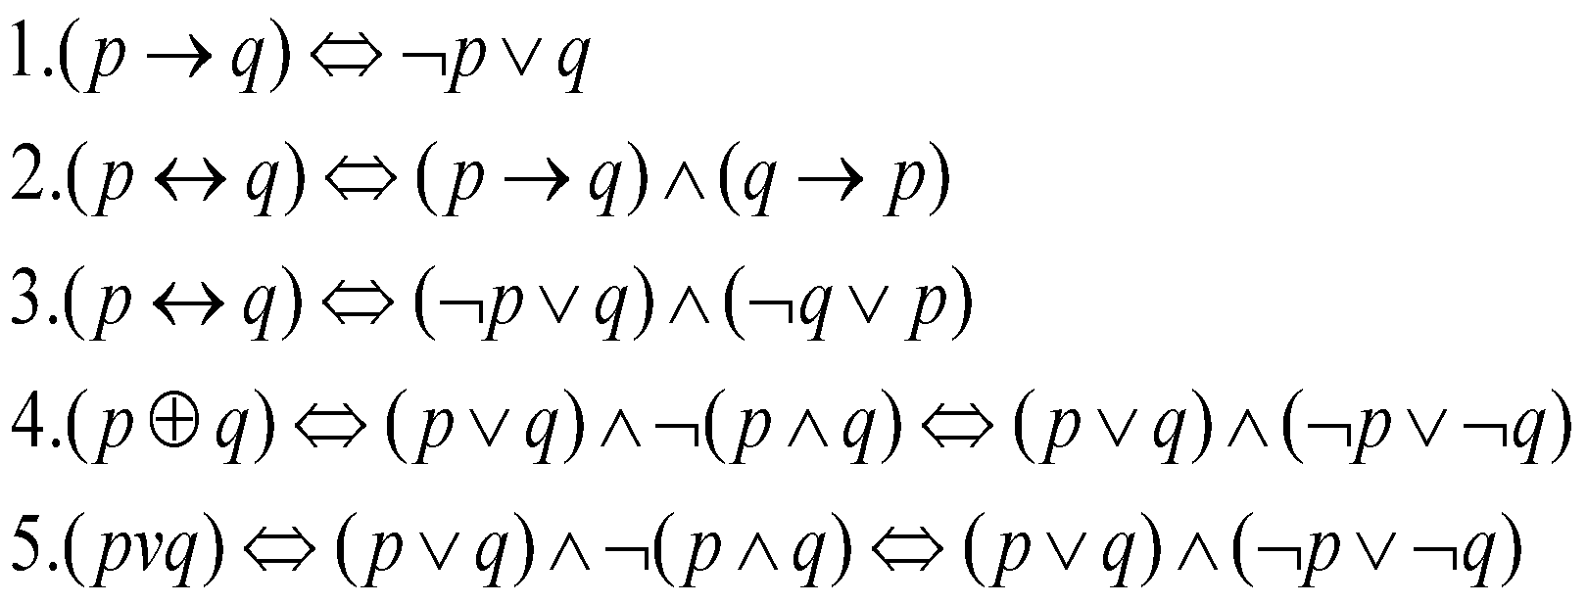
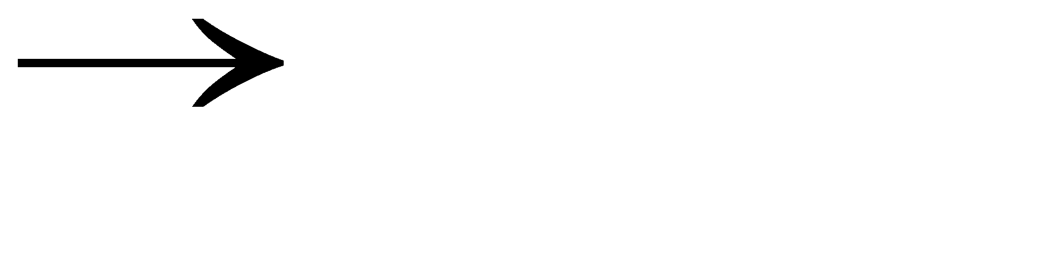
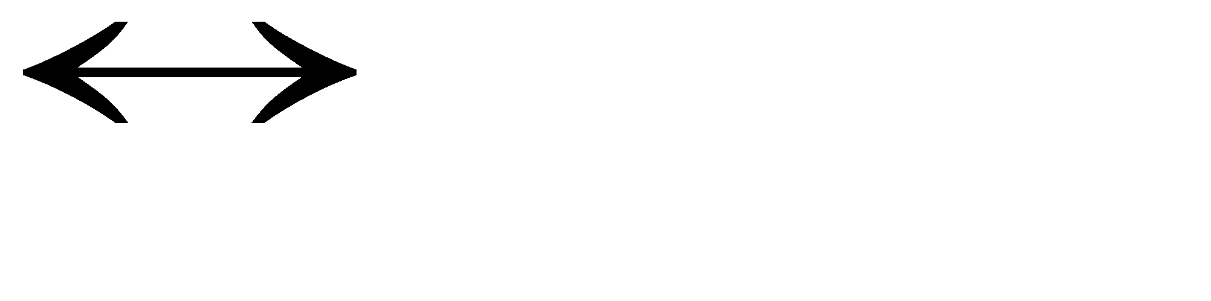
Logical Equivalence:
The Laws of Logic
NOTE: v ⇔ ⊕
We can eliminate the connectives
and
from compound statements.
(and,or,not) is a complete set.

Slide 13
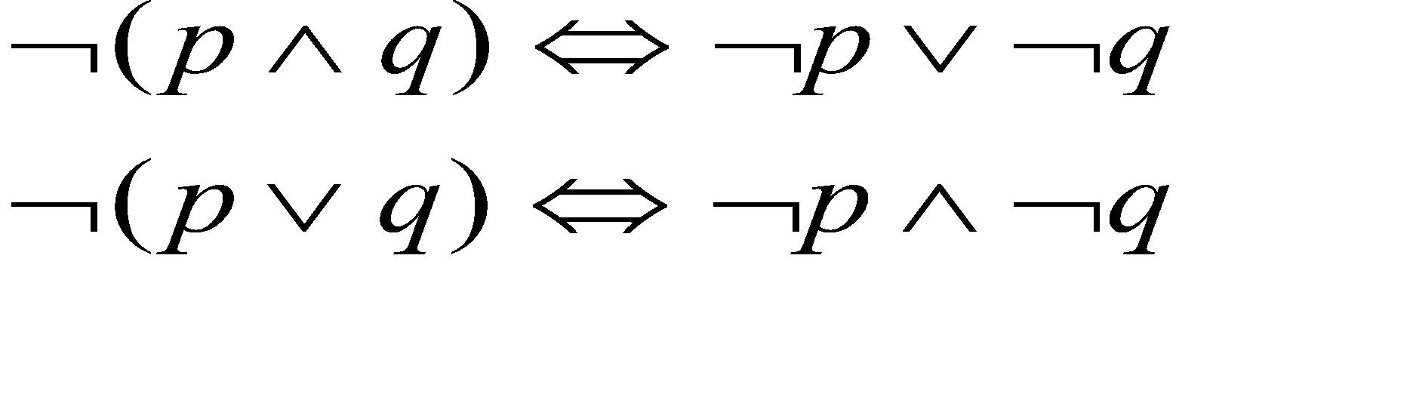
Logical Equivalence:
The Laws of Logic
Ex 2.8. DeMorgan's Laws
p and q can be any compound statements.
Distributive Laws: p ^ (q v r) ⇔ (p ^ q) v (p ^ r)
p v (q ^ r) ⇔ (p v q) ^ (p v r)

Slide 14
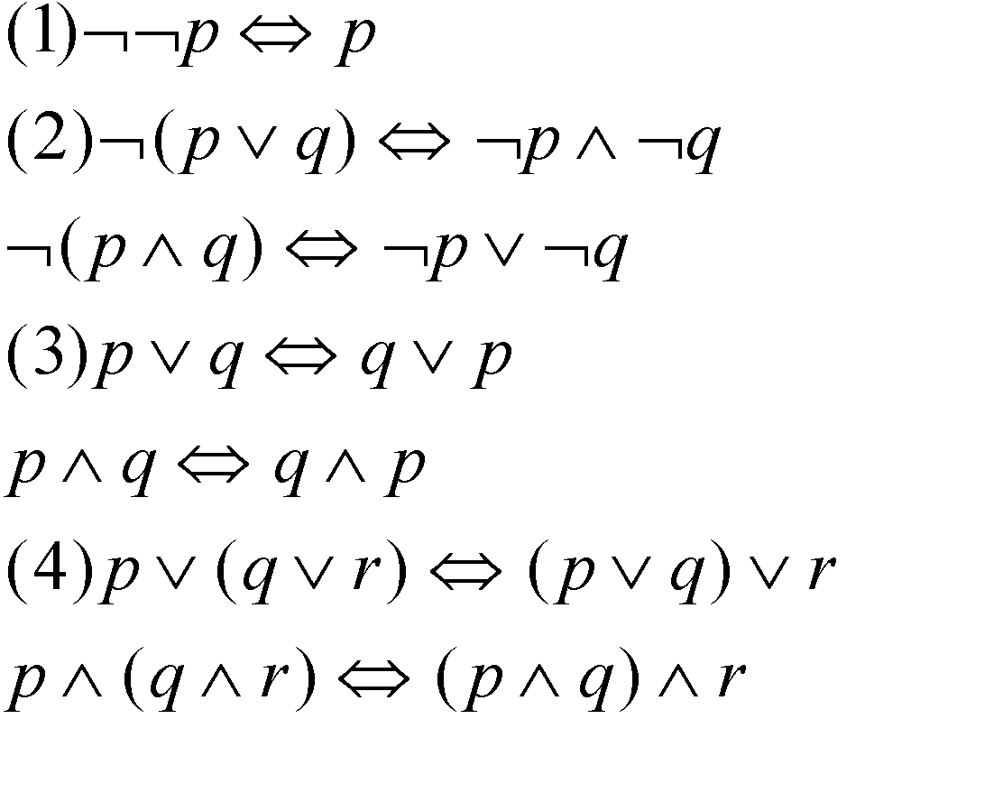
Logical Equivalence:
The Laws of Logic
Law of Double Negation
Demorgan's Laws
Commutative Laws
Associative Laws

Slide 15
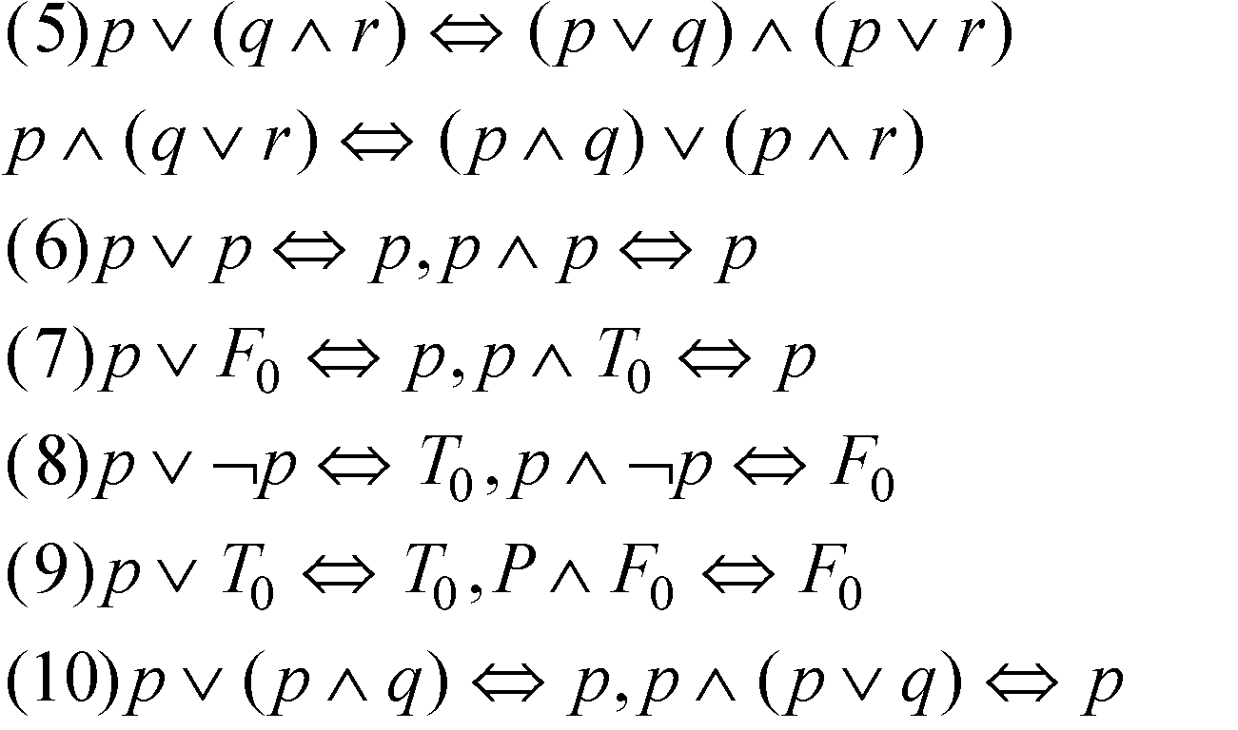
Logical Equivalence:
The Laws of Logic
Distributive Law
Idempotent Law
Identity Law
Inverse Law
Domination Law
Absorption Law

Slide 16
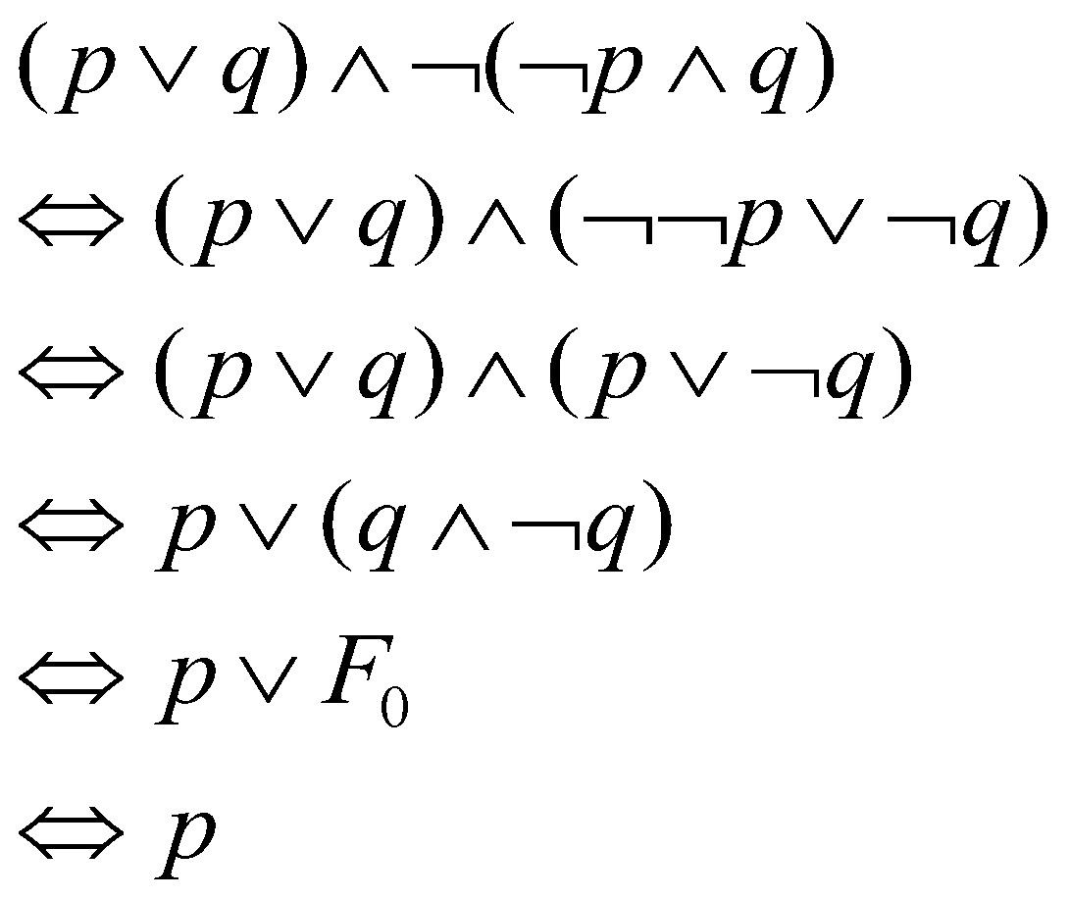
Simplify using the laws of logic:
1. (p v q )^ ¬(¬p ^ q).
Soln: Applying Demorgan’s law we get
(p v q ) ^ (¬¬p v ¬q)
Applying law of double negation we get
(p v q) ^ (p v ¬q)
By distributive law of v over ^
p v (q ^ ¬q)
By inverse law
p v F₀
By identity law we get
p
Demorgan's Law
Law of Double Negation
Distributive Law of v over ^
Inverse Law
Identity Law

Slide 17
Simplify using laws of logic:
¬[ ¬[ (p v q) ^ r ] v ¬q ]
Ans: ¬[ ¬[ (p v q) ^ r ] v ¬ q ]
¬ ¬ [(p v q) ^ r ] ^ ¬ ¬ q Applying Demorgan’s law
¬ ¬ (p v q) ^ ¬ ¬ r ^ ¬ ¬ q Applying Demorgan’s law
(((p v q) ^ r) ^ q) Law of double negation
(((p v q) ^ q) ^ r) Commutative law of ^
(((p v q) ^ q )^ r) Association law
(q ^ r) By law of obsorption
q ^ r

Slide 18
Exercises:
Prove the logical equivalence/ simplify the following using Laws of logic.
[(p v q) ^ (p v ¬q)] v q ⇔ p v q
(p → q) ^ [¬q ^ (r v ¬q)] ⇔ ¬(q v p)
p → (q → r) ⇔ (p ^ q) → r
[¬p ^ (¬q ^ r)] v (q ^ r) v (p ^ r) ⇔ r
p v [ p ^ ( p v q)] ⇔ p
p v q v (¬p ^ ¬q ^ r) ⇔ p v q v r
[(¬p ^ ¬q) → ( p ^ q ^ r)] ⇔ p ^ q

Slide 19
1. [(p v q) ^ (p v ¬q)] v q ⇔ p v q 2. (p → q) ^ [¬q ^ (r v ¬q)] ⇔ ¬(q v p)

Slide 20


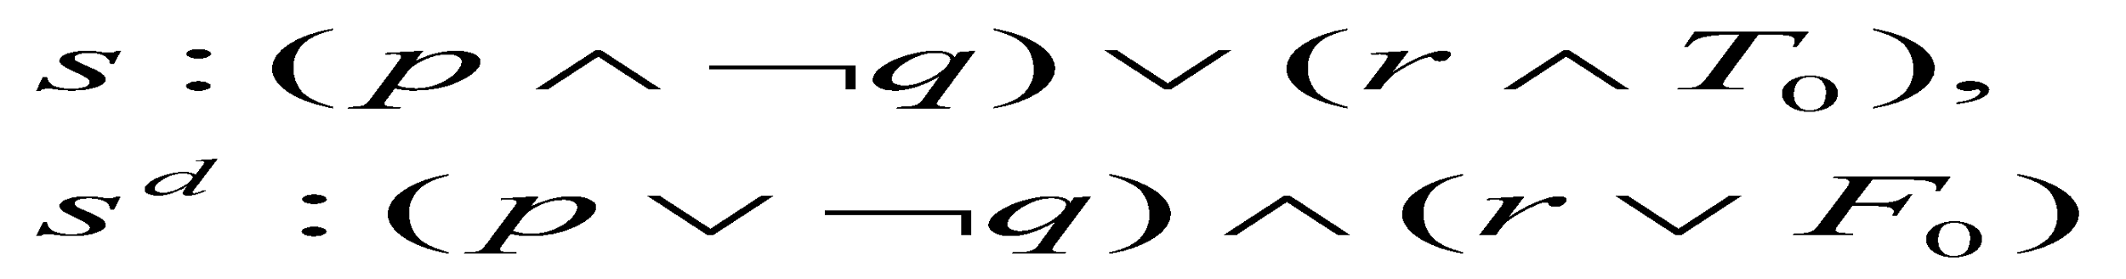
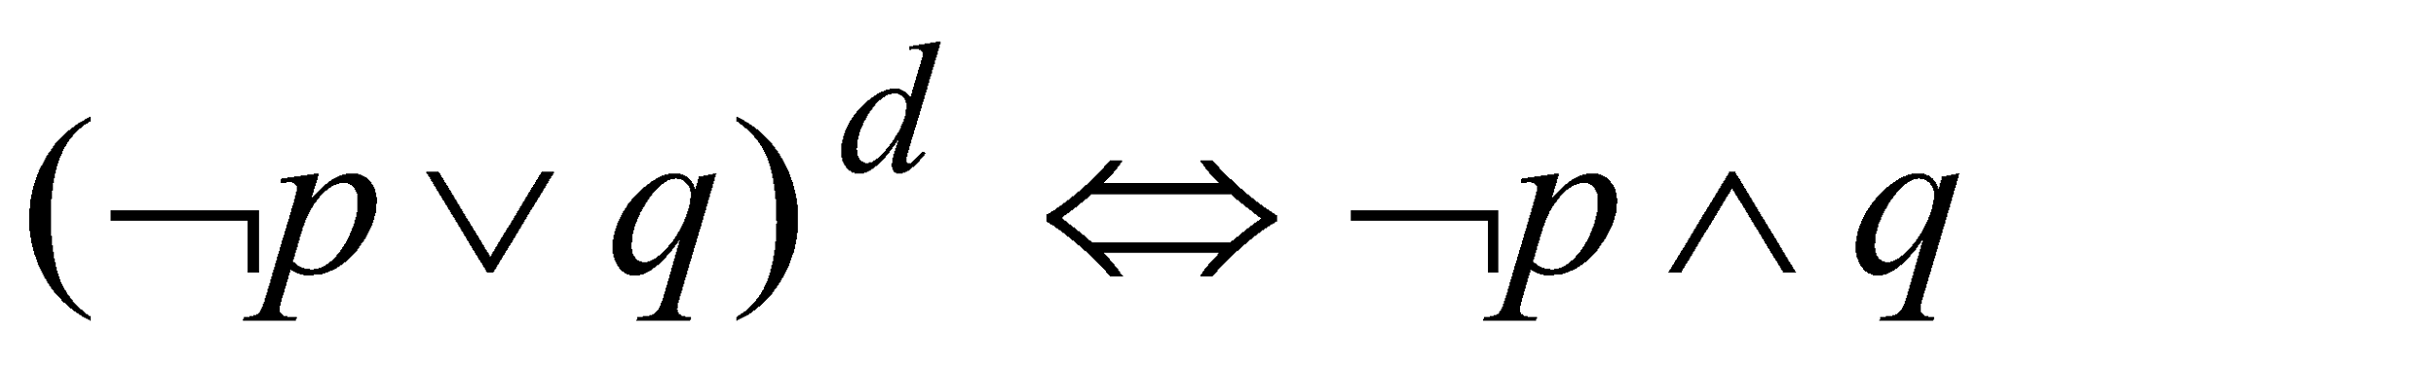
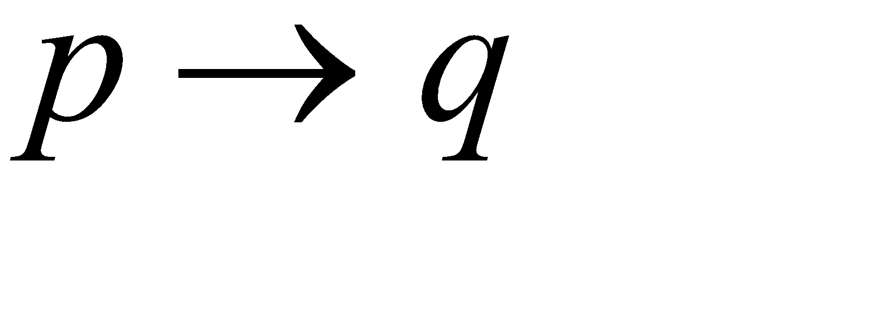
Logical Equivalence:
The Laws of Logic
All the laws, aside from the Law of Double Negation, fall naturally into pairs.
Dual of a statement
Def. 2.3 Let s be a statement. If s contains no logical connectives
other than and , then the dual of s, denoted s^{d}, is the statement obtained from s by replacing each occurrence of
and by and , respectively, and each occurrence of T₀
and F₀ by F₀ and T₀, respectively.
Ex.
The dual of is

Slide 21
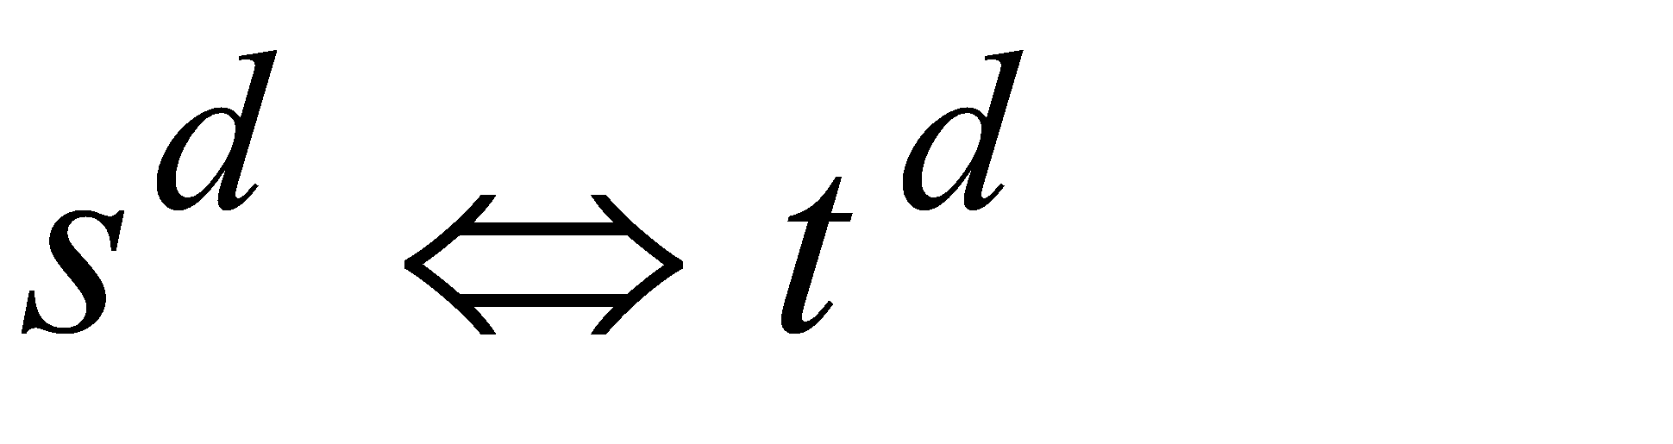
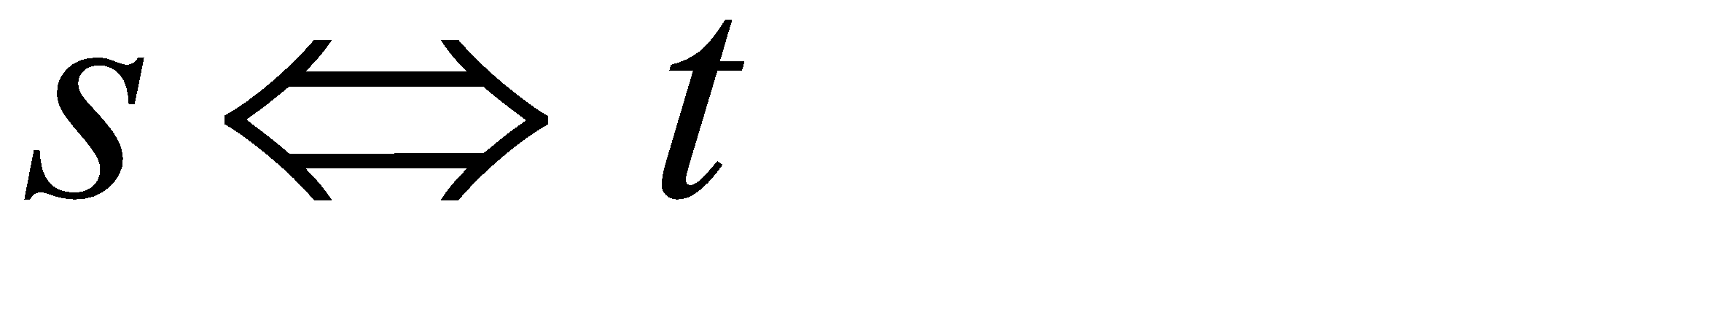
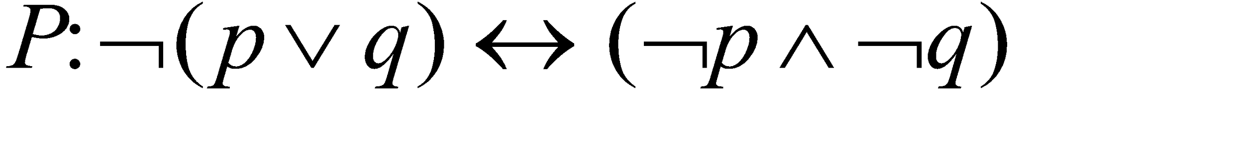
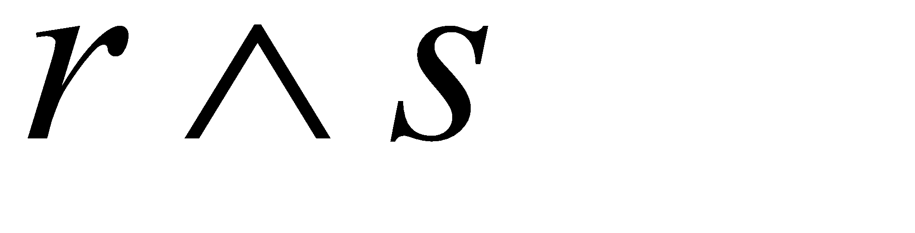
Logical Equivalence:
The Laws of Logic
Theorem 2.1 (The Principle of Duality) Let s and t be statements that contain no logical connectives other than ^ and v.
If , then
First Substitution Rule (replace each p by another statement q)
Ex. 2.10 Suppose that the compound statement P is a tautology. If p is a primitive statement that appears in P and we replace each occurrence of p by same q, then resulting compound statement P₁ is also a tautology.
is a tautology. Replace
each occurrence of p by
is also a tautology.

Slide 22
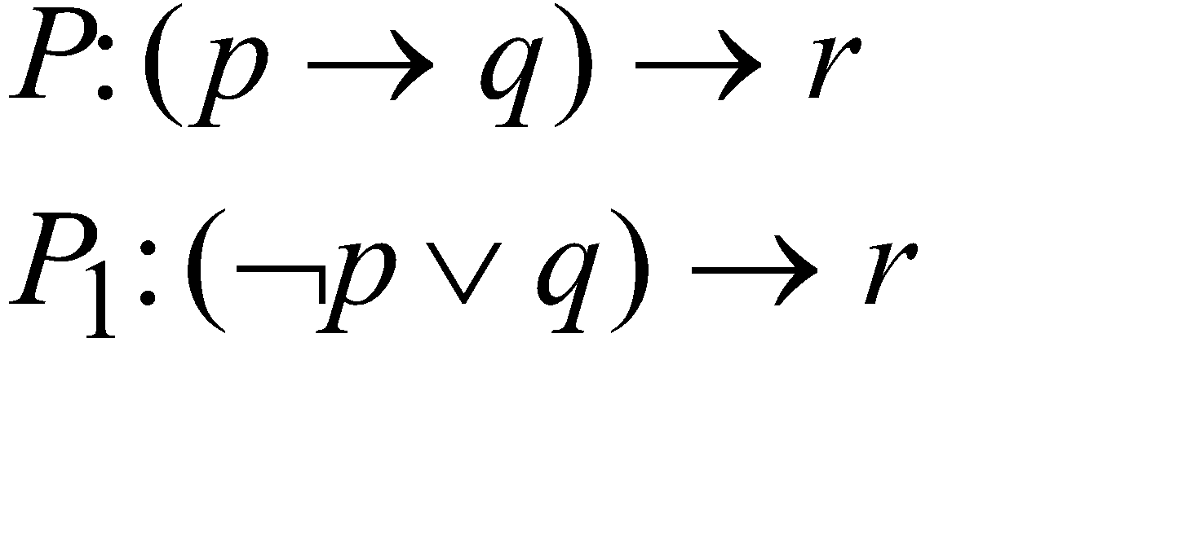
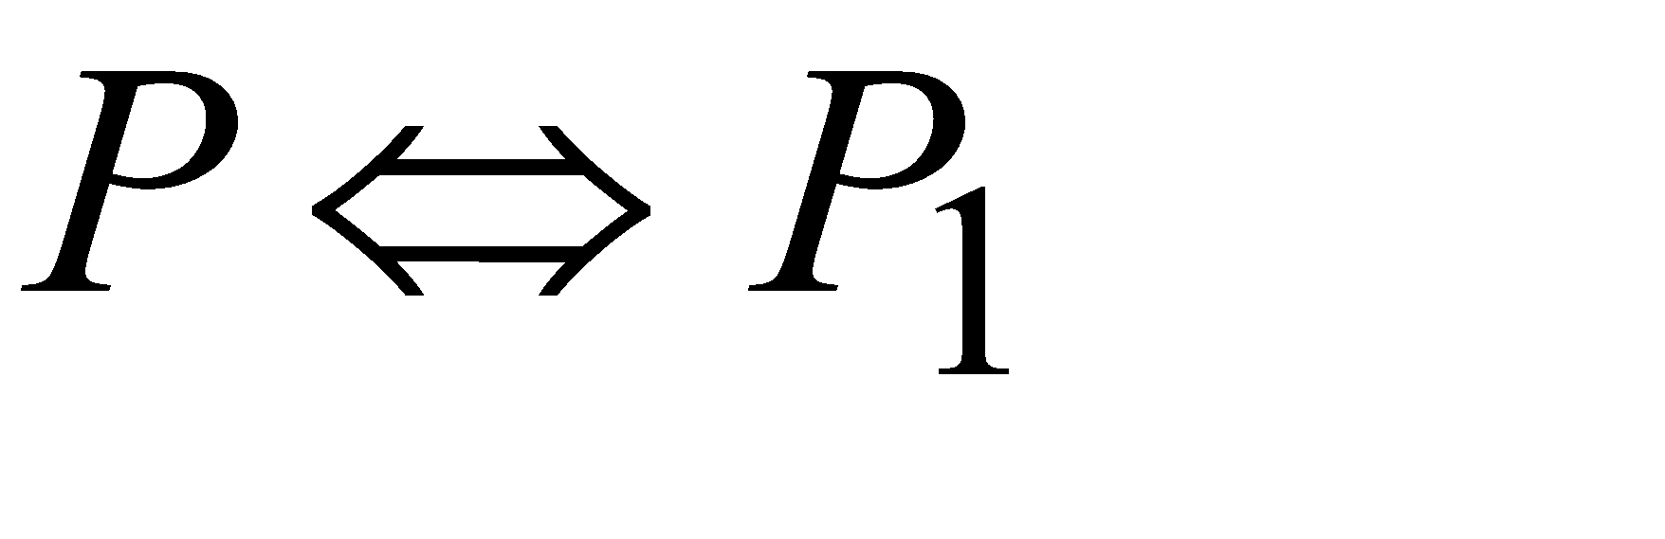
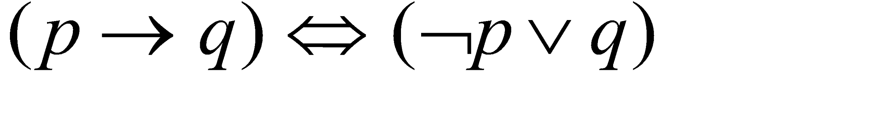
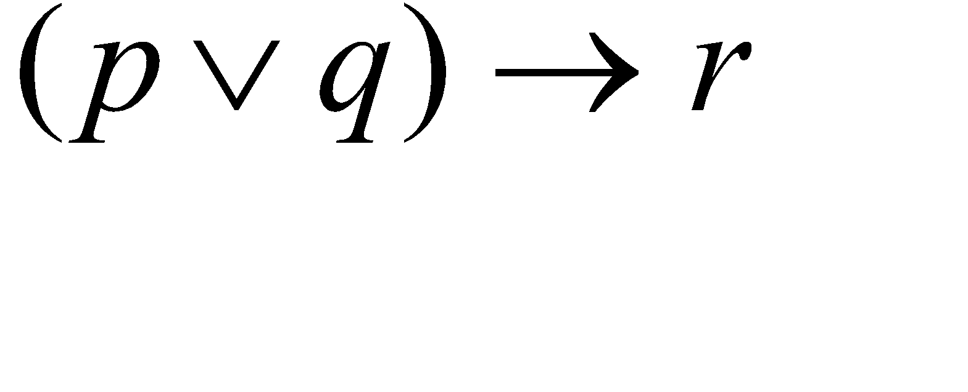
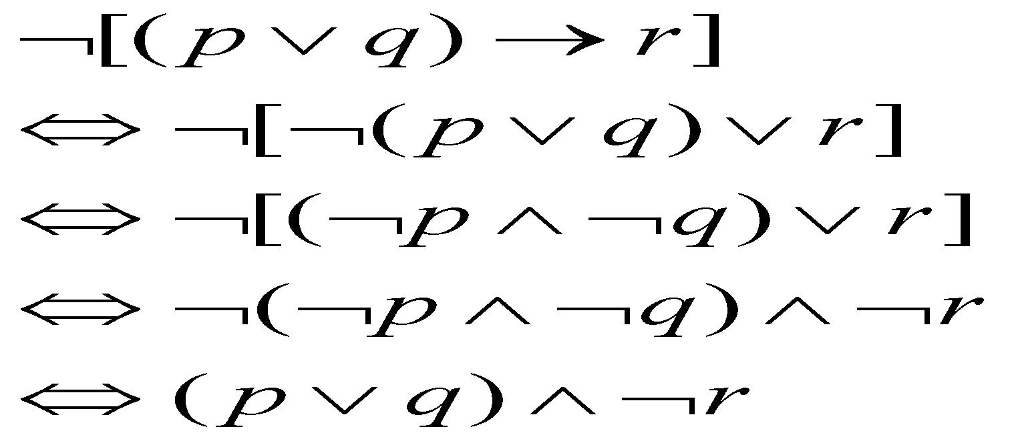
Logical Equivalence: The Laws of Logic
Second Substitution Rule :Suppose that the compound statement P is a tautology. If p is a primitive statement that appears in P and q be statement such as q ⇔ p. Suppose that in P we replace one or more occurrences of p by q. Then this replacement yields another compound statement P₁ such that P ⇔ P_{1.}
Ex. 2.11
Then,
because
Ex. 2.12 Negate and simplify the compound statement

Slide 23
Logical Equivalence:
The Laws of Logic
Ex. 2.13 What is the negation of “If Joan goes to Lake George, then Mary will pay for Joan's shopping spree.”?
Soln: p: Joan goes to Lake George
q: Mary will pay for Joan’s shopping spree.
Then above statement is equivalent to p → q. Negation of it will be
The negation is "Joan goes to Lake George, but (or and)
Mary does not pay for Joan's shopping spree."

Slide 24
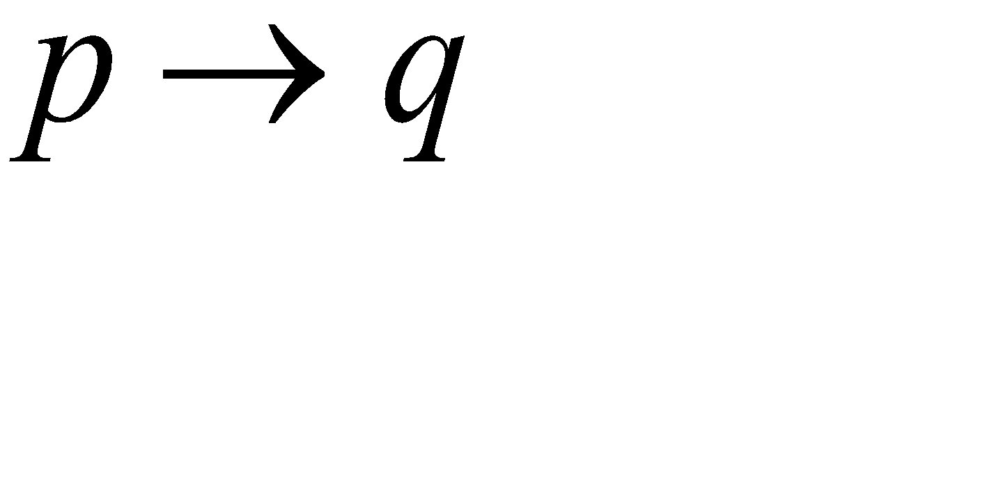
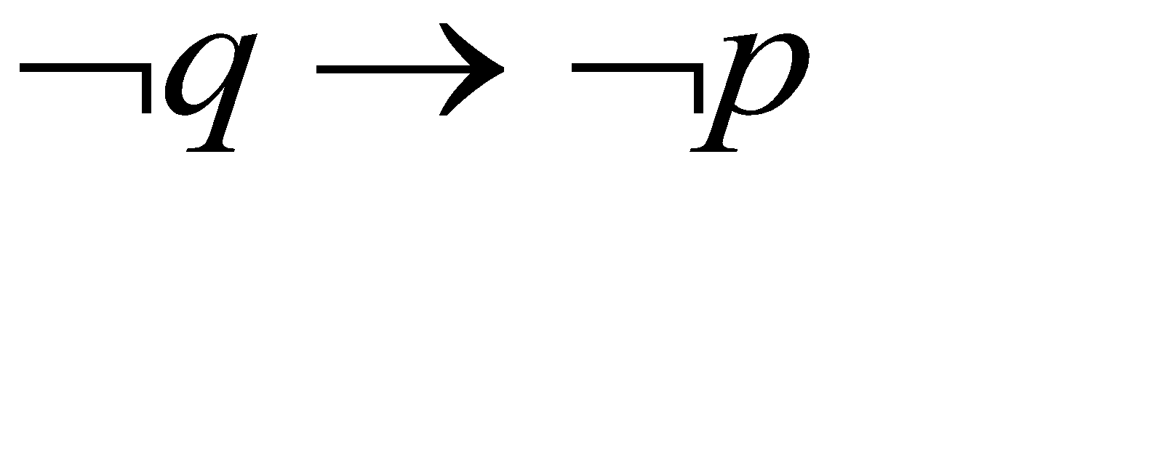
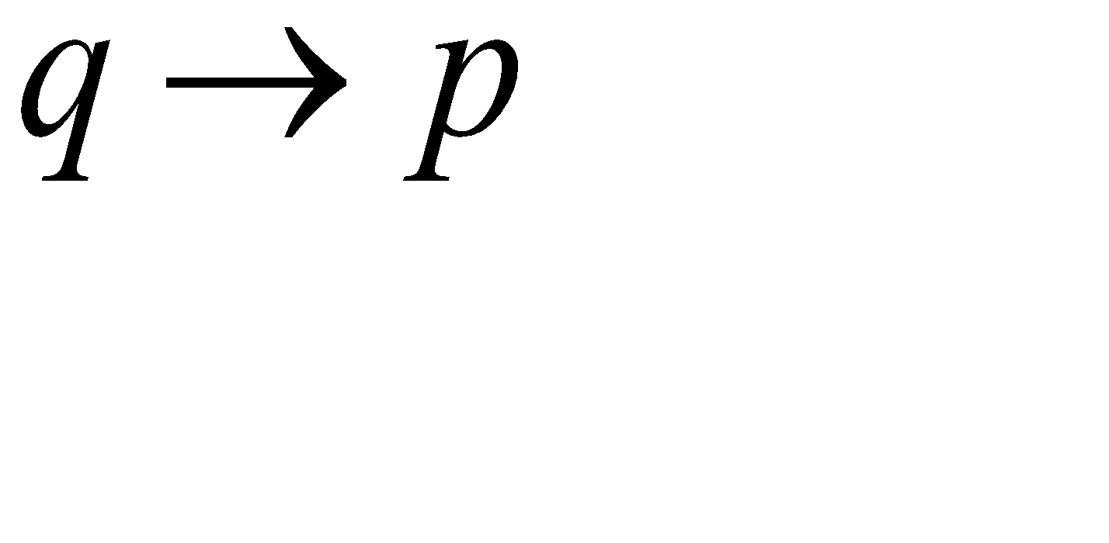
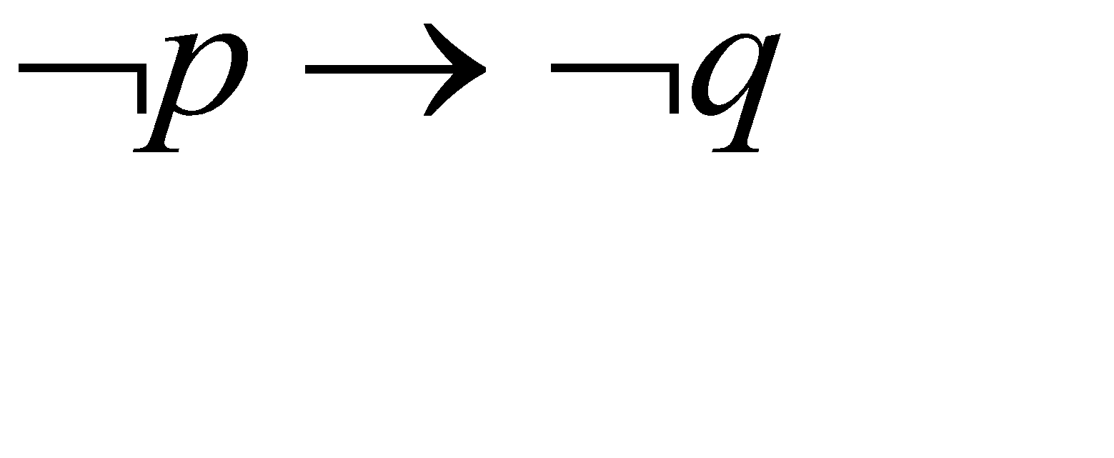
Logical Equivalence:
The Laws of Logic
Ex. 2.15
Contrapositive, Converse and Inverse of p →q
p
q
0
0
1
1
0
1
0
1
1
1
0
1
1
1
0
1
1
0
1
1
1
0
1
1
NOTE: 1. p →q ⇔ (¬q → ¬p) That is implication is equivalent to its contra positive
2. q →p ⇔ (¬p → ¬q) Converse is equivalent to inverse.

Slide 25
Writing converse, Inverse and contra positives of implication
If sun is shining, then it is warm
Soln: Let p: sun is shining
q: it is warm
Given statement is p → q
Converse: q → p
if it is warm, then sun is shining
Inverse: ¬p → ¬q
If sun is not shining, it is not warm
Contra positive: ¬q → ¬p
if it is not warm, then sun is not shining.

Slide 26
2. If it is a dog, then it barks
Soln: Let p: it is a dog
q: it barks
Given statement is p → q
Converse: q → p
if it barks, then it is a dog
inverse: ¬p → ¬q
if it is not a dog, then it does not bark
Contra positive: ¬q → ¬p
if it does not bark, then it is not a dog

Slide 27
Write the converse of the following statements in words:
if you buy colgate then your children will brush longer
When you serve imported sparkling water, it shows that you had good taste.
Write the inverse of the following statements in words:
If you live to an old age, then you eat nano yogurt.
If you drive a superb car, then you will get good milage.
Write the contra positive of the following statements in words
If you brush with brite, then your teeth will be pearly white
If you want a good job, then you will get high school diploma.

Slide 28
Write inverse, converse and contra positive of following statements
If today is Friday, then tomorrow is Saturday
If Douglas does well in the college, then he will apply to medical
If a man is honest, he will not steal
If John does not water the plants, then the plants will die.
If Bob does his home work, then John gets candy.
If a dog is great Dane, then it is large.

Slide 29
Logical Implication:
Rules of Inference
an argument:
Premises/hypothesis
conclusion
is a valid argument
is a tautology

Slide 30
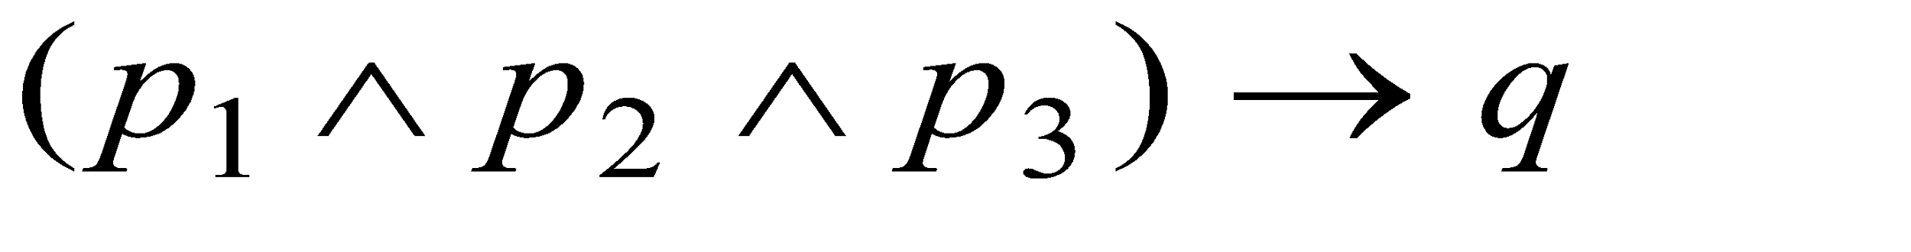
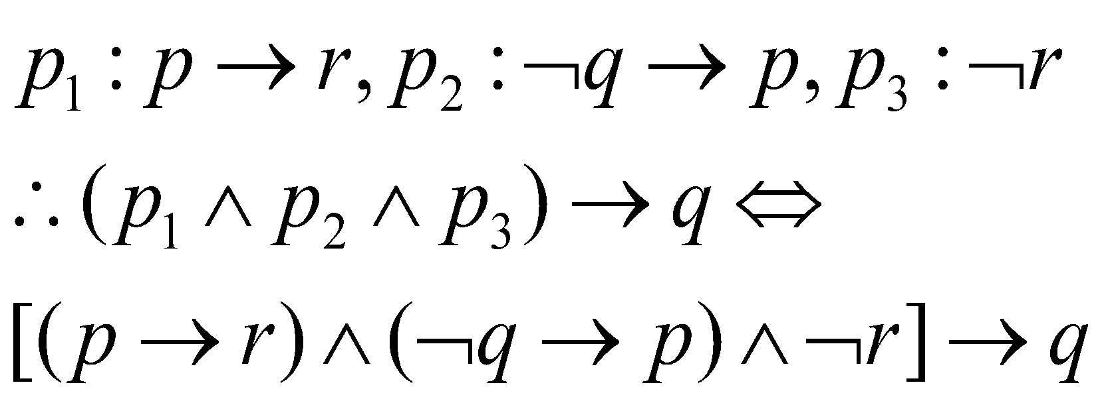
Logical Implication:
Rules of Inference
Ex. 2.19 statements: p: Roger studies. q: Roger plays tennis.
r: Roger passes discrete mathematics.
premises: p₁: If Roger studies, then he will pass discrete math.
p₂: If Roger doesn't play tennis, then he'll study.
p₃: Roger failed discrete mathematics.
Determine whether the argument
which is a tautology,
the original argument
is true
is valid.
Prepare truth table to show it is a Tautology.

Slide 31
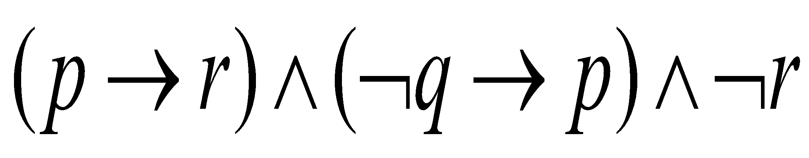
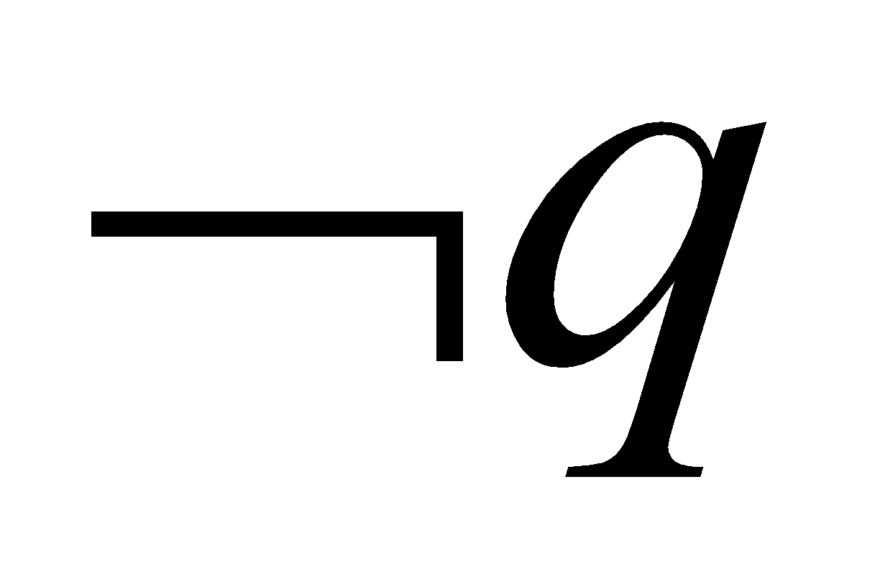
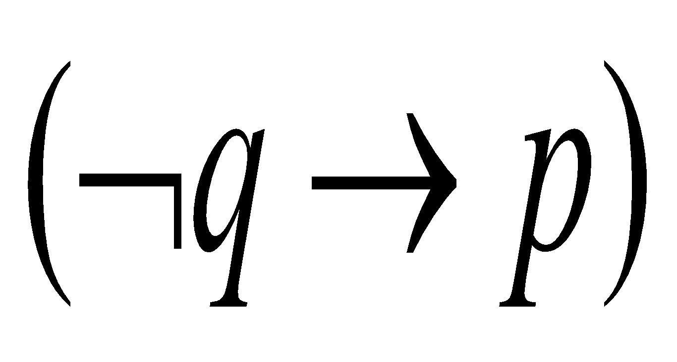
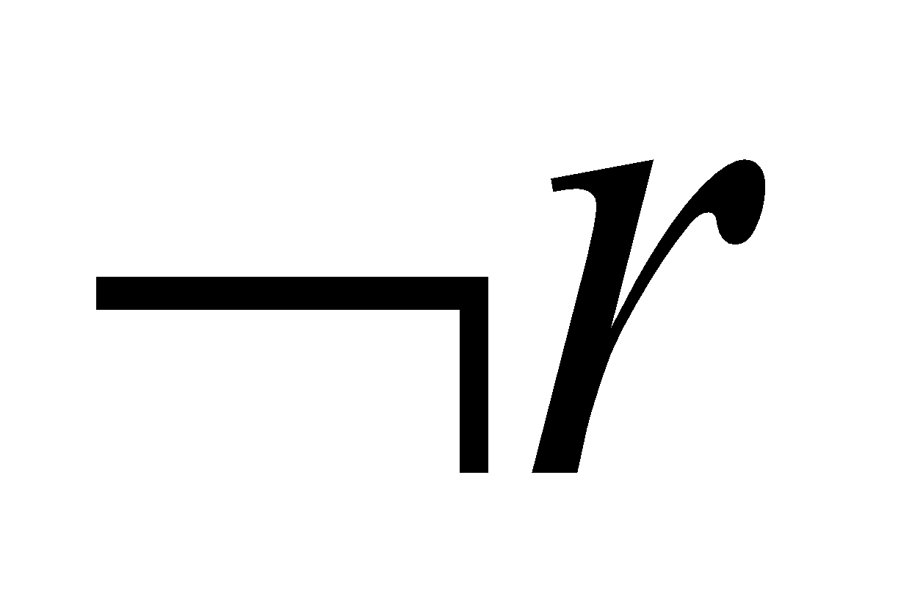
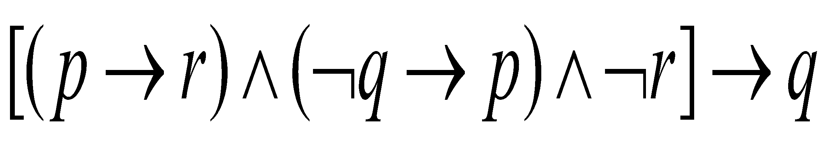
p | q | r |  | p->r
0 | 0 | 0 | 1 | 1 | 0 | 1 |  | 0 |  | 1
0 | 0 | 1 | 1 | 1 | 0 | 0 |  | 0 |  | 1
0 | 1 | 0 | 0 | 1 | 1 | 1 |  | 1 |  | 1
0 | 1 | 1 | 0 | 1 | 1 | 0 |  | 0 |  | 1
1 | 0 | 0 | 1 | 0 | 1 | 1 |  | 0 |  | 1
1 | 0 | 1 | 1 | 1 | 1 | 0 |  | 0 |  | 1
1 | 1 | 0 | 0 | 1 | 1 | 1 |  | 1 |  | 1
1 | 1 | 1 | 0 | 1 | 1 | 0 |  | 0 |  | 1

Slide 32
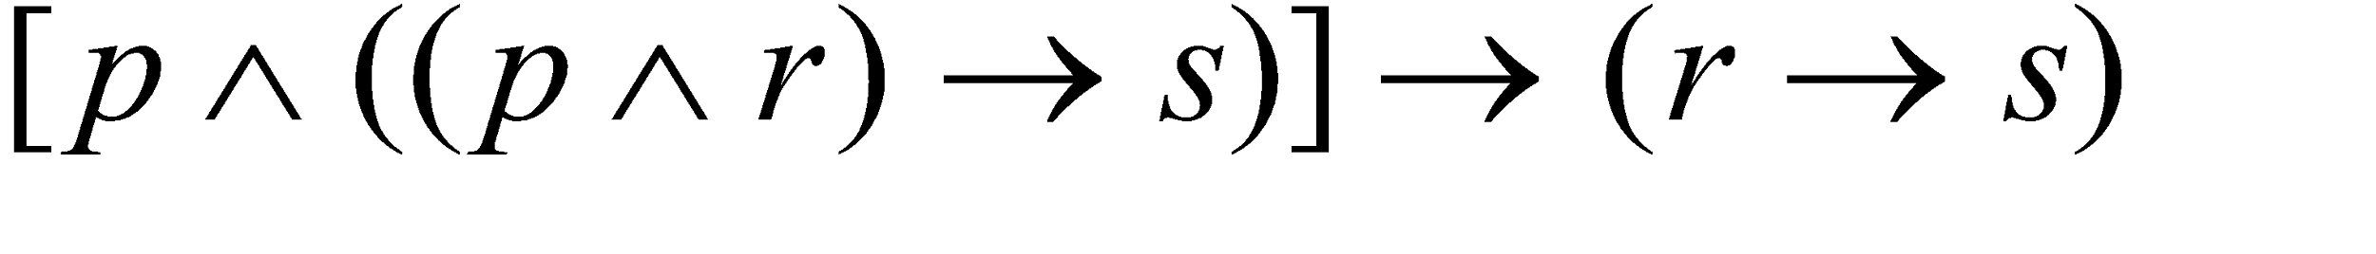
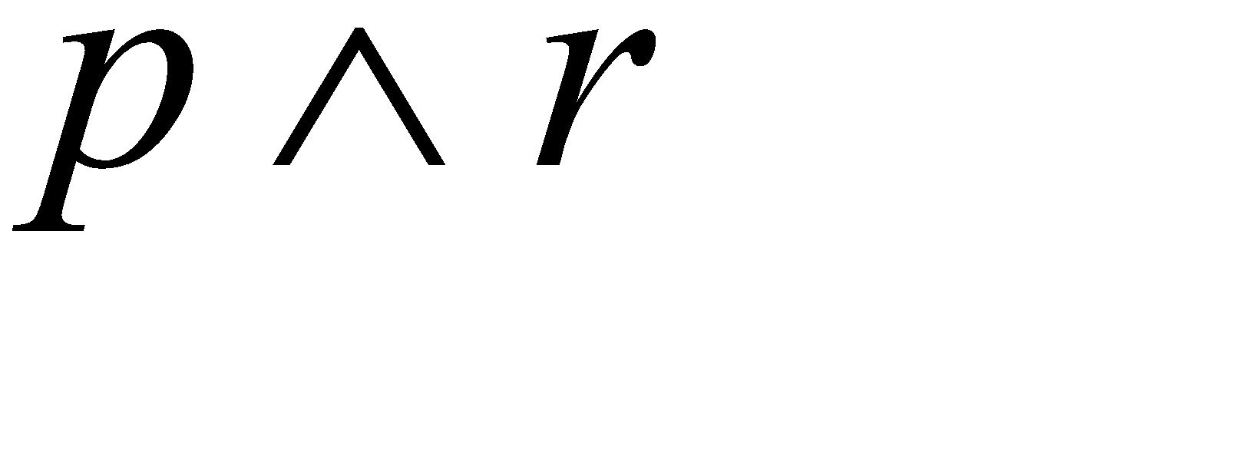
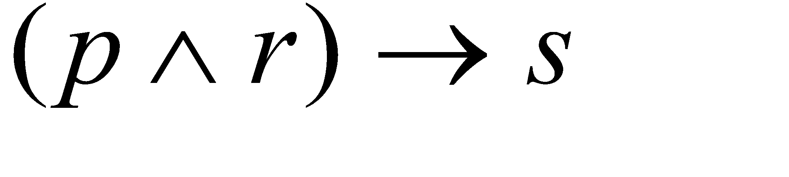
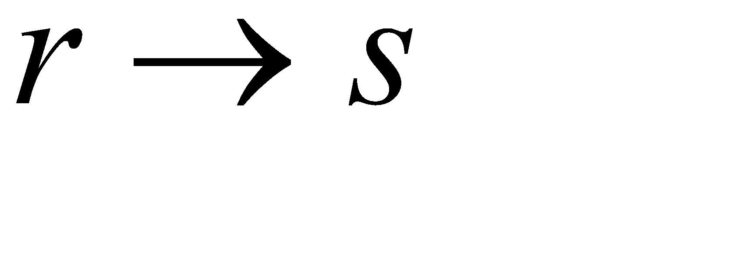
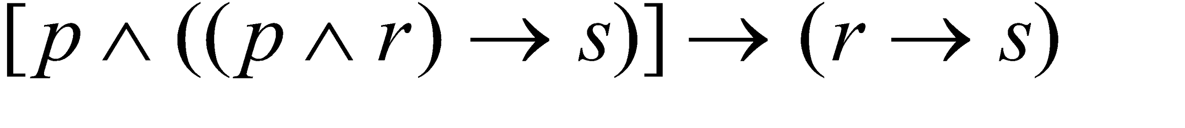
Logical Implication: Rules of Inference
Ex. 2.20 Show that is a Tautology.
p r s
0 0 0 0 1 1 1
0 0 1 0 1 1 1
0 1 0 0 1 0 1
0 1 1 0 1 1 1
1 0 0 0 1 1 1
1 0 1 0 1 1 1
1 1 0 1 0 0 1
1 1 1 1 1 1 1
a tautology
deduced or
inferred from
the two
premises

Slide 33
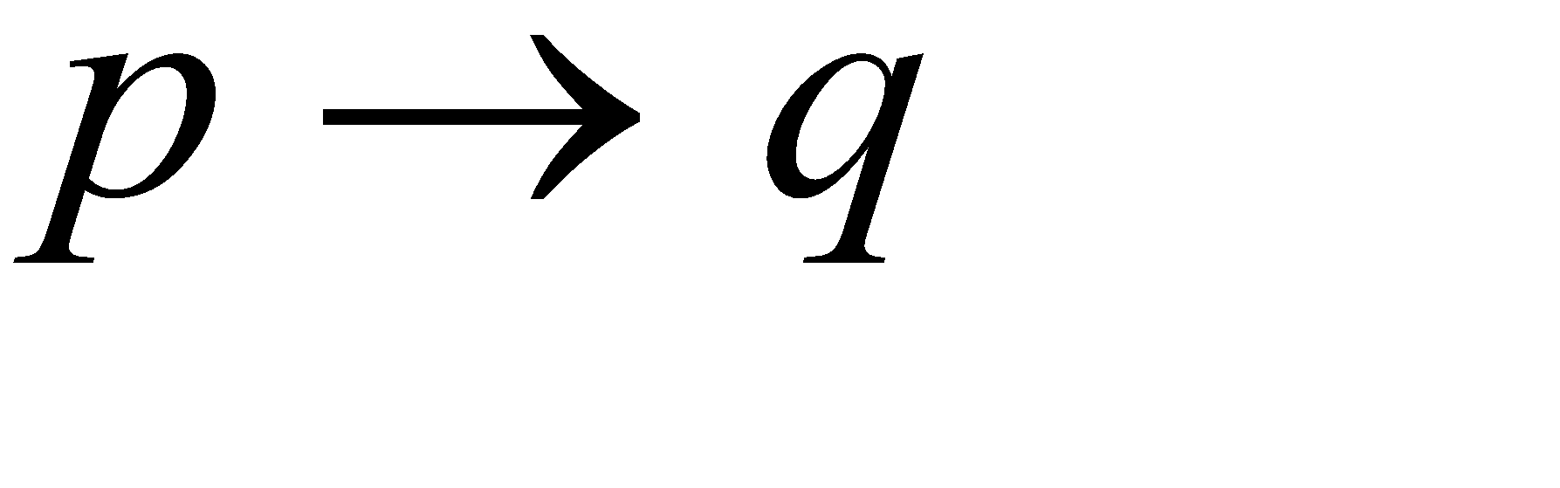
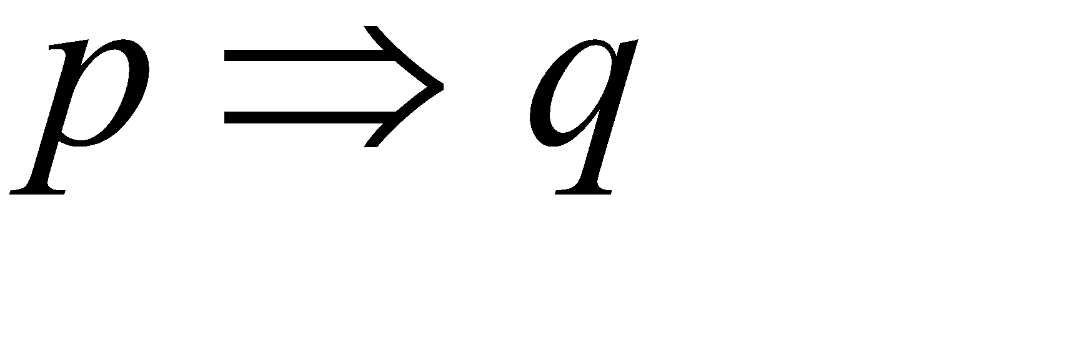
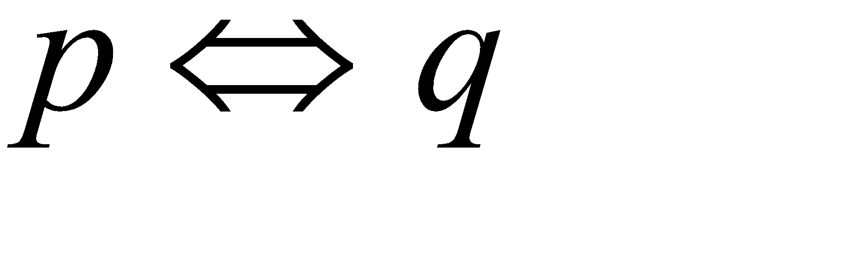



Logical Implication: Rules of Inference
Def. 2.4. If p, q are any arbitrary statements such that
is a tautology, then we say that p logically implies q and we
write
to denote this situation.
means
is a tautology.
means
is a tautology.

Slide 34


Logical Implication: Rules of Inference
Rule of inference: Used to validate or invalidate a logical implication without resorting to truth table (which will be prohibitively large if the number of variables are large)
Ex 2.22 Modus Ponens or (the method of affirming) or the Rule of Detachment

Slide 35
Modus Ponens Proof:
p ^ (p → q)
⇔ p ^ (¬p v q) ∵ p is true,
⇔ T₀ ^ (F₀ v q) By Idempotent law
⇔ (F₀ v q) By Idempotent law
⇔ q

Slide 36



Logical Implication: Rules of Inference
Example 2.23 Law of the Syllogism
Ex 2.25

Slide 37
Prove the validity of arguments: p → r
r → s
t v ¬s
¬t v u
¬u
∴ ¬p
Soln: Step # Statements Reason
1: p → r, r → s Premise
2: p → s 1, Law of syllogism
3. t v ¬s premise
4. ¬s v t commutative law
5. s → t 4, 4 ⇔ s → t
6. ¬t v u premise
7. t → u 6, 6 ⇔ t → u
8. s → u 5, 7, law of syllogism
9. p → t 2, 5, law of syllogism
10. p → u 9, 7, law of syllogism
11. ¬u Premise
12. ∴ ¬p 10,11, Modus Tollens

Slide 38







Logical Implication: Rules of Inference
Ex. 2.25 Modus Tollens (method of denying)
example:
another reasoning

Slide 39

Logical Implication: Rules of Inference
fallacy
(1) If Margaret Thatcher is the president of the U.S., then she
is at least 35 years old.
(2) Margaret Thatcher is at least 35 years old.
(3) Therefore, Margaret Thatcher is the president of the US.

Slide 40


Logical Implication: Rules of Inference
fallacy
(1) If 2+3=6, then 2+4=6.
(2) 2+3
(3) Therefore, 2+4
6
6

Slide 41


Logical Implication: Rules of Inference
Ex 2.26 Rule of Conjunction
Ex. 2.27 Rule of Disjunctive Syllogism

Slide 42



Logical Implication: Rules of Inference
Ex. 2.28 Rule of Contradiction
Proof by Contradiction
To prove
we prove

Slide 43

Logical Implication: Rules of Inference
Ex. 2.29 Prove the validity of argument
Soln :
Step # Statements Reason .
1: ¬ p → q Premise
2: q → s premise
3. ¬ p → s 1,2, law of syllogism
4: p → r premise
5. ¬ r → ¬ p contra positive of 4
6. ∴ ¬ r → s 5,3, law of syllogism

Slide 44


Logical Implication: Rules of Inference
Ex. 2.30 Prove the validity of the argument
q
r, s
p, t
u
No systematic way to prove except by truth table (2^{n}).

Slide 45
Exercises:
Show the validity of the following arguments:
1. [((¬ p v ¬ q) → (r ^ s)) ^ (r → t) ^ ¬ t ] → p
2. [(u → r) ^ ((r ^ s) →(p v t)) ^ (q → (u ^ s)) ^ (¬ t)] → (q → p)
3. [(p → q) ^ (¬ q) ^ (¬ r)] → (¬p v r)
4. [(p ^ q) ^ (p → (r ^ q)) ^ (r → (s v t)) ^ (¬s)] → t
5. [(p → (q → r)) ^ (¬ q→ p) ^ p] → r (Hint use contra positive of implication)
6. Show that argument is invalid [(p ^ ¬ q) ^ (p → (q → r))] → ¬ r
Soln : if argument is invalid then ¬ r is 0 ⇒ r =1
given p → (q → r) is true
if p=0, then q → r can be 0 or 1 for q → r to be 1
if (q → r)= 0 then q=1, r=0 which contradicts that r=1
∴ (q → r)= 1
∵ (q → r)= 1 , and (p → (q → r)=1 implies p=1
∵ p ^ ¬ q = 1 ∴ ¬ q = 1 ⇒ q=0
∴ when p=1,q=0,r=1 the premises are true and conclusion is false.

Slide 46


Logical Implication: Rules of Inference
Ex 2.32 Proof by Contradiction to prove the validity of the argument
q
r
F₀

Slide 47



Logical Implication: Rules of Inference
Note: whenever conclusion is an implication, then argument of conclusion is taken as one more premise and we will prove conclusion.
reasoning

Slide 48




Logical Implication: Rules of Inference
Ex 2.33 Show the validity of the argument
r
u, s
p

Slide 49



Logical Implication: Rules of Inference
How to prove that an argument is invalid?
Just find a counterexample (of assignments) for it !
Ex 2.34 Prove the following to be invalid.
p=1
q=0
1
r=1
0
s=0,t=1

Slide 50
Determine the truth values of the following:
If 3+4 = 12 then 3+2 = 6
Soln: Let p: 3+4 = 12
q: 3+2 = 6
Here both p and q are false
∴ p → q is true.
b) If 3+3=6 then 3+4=9
Ans: false
c) If Thomas Jefferson was third President of US, then 2+3=5
Soln: Let p: Thomas Jefferson was third President of US
q: 2+3=5
Here q is true.
when q is true is p → q is independent of p is true.

Slide 51
Determine all truth value assignments if any for primitive statements p, q, r, s, t which make compound statement false.
[(p ^ q) ^ r] → (s v t)
Soln: For implication p → q to be false p=1, q=0
∴ s v t =0 ⇒ s=0 and t=0
And [(p ^ q) ^ r] =1 ⇒ (p ^ q) =1 and r=1 ⇒ p=1 q=1
∴ p=1,q=1,r=1,s=0,t=0 makes the statement false
b) [p ^ (q ^ r )] → (s v t)
Ans: p=1,q=1,r=1,s=1,t=1
c) If q=1 determine p, r, s which make
(q → [(¬p v r) ^ ¬s] ^ [¬s → (¬r ^ q)] is 1
Ans: p=0,r=0,s=0

Slide 52
In the following program segment i, j, m, n are integer variables. The values of m and n are supplied by user earlier in execution of program.
for i=1 to m do
for j=1 to n do
if i ≠ j then
print i+j
How many times the print statement is executed if
m=10,n=10
m=20, n=20
m=10, n=20
m=20, n=10
Soln: # times print statement is executed is (n-1)m=(m-1)n when m=n
m(n-1) when m<n
n(m-1)when m>n

Slide 53

Write the circuit diagram for the following:
a) (p v q v r ) ^ (p v t v ¬q) ^ (p v ¬ t v r)
b) [p ^ (¬r v q v ¬ q)] V [(r v t v ¬ r) v ¬q]
c) [p v (p ^ q) v ( p ^ q ^ ¬r)] ^ [(p ^ r ^ t) v t]

Slide 54
Rule of Conjunctive Simplification :
p^q
∴ p
∴ q
Rule of Disjunctive Amplification:
p
∴ p v q
Rule of conditional proof:
p ^ q
p →(q → r)
∴ r
Rule for proof by cases:
p → r
q → r
∴ (p v q) → r

Slide 55
Rule of Constructive Dilemma
p → q
r → s
p v r
∴ q v s
Rule of Distructive Dilemma
p → q
r → s
¬q v¬ s
∴ ¬p v¬ r
NOTE:
↑ - NAND operator
a ↑ b ⇔ ¬(a ^ b) ⇔ ¬a v ¬b
↓ - NOR operator
a ↓ b ⇔ ¬(a v b) ⇔ ¬a ^ ¬b

Slide 56
The Use of Quantifiers
Def. 2.5 A declarative sentence is an open statement if
(1) it contains one or more variables, and
(2) it is not a statement, but
(3) it becomes a statement when the variables in it are replaced
by certain allowable choices.
Universe of disclosure for open st.
Examples:
One variable open statement-
p(x) : The number x+2 is an even integer.
Two variables open statement –
q(x, y) : x=y, x>y, x<y, ...

Slide 57




The Use of Quantifiers
notations:
p(x): The number x+2 is an even integer.
q(x,y): The numbers y+2, x-y, and x+2y are even integers.
p(5): FALSE,
: TRUE, q(4,2): TRUE
p(6): TRUE,
: FALSE, q(3,4): FALSE
Therefore,
For some x, p(x) is true.
For some x & y, q(x,y) is true.
For some x, is true.
For some x &y, is true.

Slide 58




The Use of Quantifiers
Types of Quantifiers
Existential quantifier: For some x or for atleast one x or there exists an x. Universal quantifier: For all x or for any x or for each x or for every x.
x in p(x): free variable. That is as x varies, truth value of p(x) may vary
x in : bound variable
is either true or false.

Slide 59


The Use of Quantifiers
Ex 2.36 Quantifiers are used in conjunction with logical connectives
Universe is: real numbers R
x=4 or x=2 or x=1………..
x=1
x=5,6,...
x=-1
NOTE: 1. ∀x p(x) ⇒ ∃x p(x)
2. ∃x p(x) ⇏ ∀x p(x)

Slide 60



The Use of Quantifiers
Ex 2.37 implicit quantification – is universal quantification
is
"The integer 41 is equal to the sum of two perfect squares” is

Slide 61
p(x), q(x) are open statements
∀x [ p(x) → q(x)]
Then for above implication,
Contra positive is ∀x [¬q(x) → ¬p(x)]
Converse is ∀x [q(x) → p(x)]
Inverse is ∀x [¬p(x) → ¬q(x)]
NOTE: Implication and Contra positive are logically equivalent.
Inverse and Converse are also logically equivalent.
∃x [r(x) ^ s(x)] ⇔ ∃x r(x) ^ ∃x s(x)
Also [∃x r(x) ^ ∃x s(x)] ⇏ ∃x [r(x) ^ s(x)]
But,
∃x [r(x) ^ s(x)] ⇒ [∃x r(x) ^ ∃x s(x)]
∃x [r(x) v s(x)] ⇔ [∃x r(x) v ∃x s(x)]
∀x [r(x) ^ s(x)] ⇔ [∀x r(x) ^ ∀x s(x)]
[∀x r(x) v ∀x s(x)] ⇒ ∀x [r(x) v s(x)]

Slide 62
Associativity over ^ and v with ∀ is satisfied
Demorgans over ^ and v with ∀ is satisified
Double negation with ∀ is also satisified.
Rules for negating statements with one quantifier
¬[∀x p(x)] ⇔ ∃x ¬p(x)
¬[∃x p(x)] ⇔ ∀x ¬ p(x)
¬[∀x ¬ p(x)] ⇔ ∃x p(x)
¬[∃x p(x)] ⇔ ∀x p(x)
Find negation of following:
∀x [p(x) →q(x)]
Soln: ∀x [p(x) →q(x)]
⇔ ∀x [¬p(x) v q(x)]
Negation of above statement is
¬[∀x [¬p(x) v q(x)]]
⇔ ∃x [¬(¬p(x) v q(x))] ⇔ ∃x [p(x) ^ ¬q(x)]

Slide 63

multiple variables
Find negation of following:
2. ∀x ∃y [ (p(x, y) ^ q(x, y) )→r(x, y)]
Soln:Negation of above statement is
¬[∀x ∃y [ (p(x,y) ^ q(x,y) )→r(x,y)]]
⇔ ∃x [¬ ∃y [(p(x,y) ^ q(x,y) )→r(x,y)]]
⇔ ∃x [∀y ¬ [(p(x,y) ^ q(x,y) )→r(x,y)]]
⇔ ∃x [∀y ¬[¬(p(x,y) ^ q(x,y) ) v r(x,y)]]
⇔ ∃x ∀y [(p(x,y) ^ q(x,y) ^ ¬r(x,y)]

Slide 64



The Use of Quantifiers
Def. 2.6 logically equivalent for open statement p(x) and q(x)
, i.e.,
for any x
p(x) logically implies q(x)

Slide 65




The Use of Quantifiers
Ex. 2.42 Universe: all integers I
then
is false
but
is true
Therefore,
but
for any p(x), q(x) and universe

Slide 66

The Use of Quantifiers
For a prescribed universe and any open statements p(x), q(x):
Note this!

Slide 67


The Use of Quantifiers
Ex. 2.44
p(x): x is odd.
q(x): x²-1 is even.
Negate
(If x is odd, then x²-1 is even.)
There exists an integer x such that x is odd and x²-1 is odd.
(a false statement, the original is true)

Slide 68



The Use of Quantifiers
BUT
Ex. 2.48 p(x,y): x+y=17.
: For every integer x, there exists an integer y such
that x+y=17. (TRUE)
: There exists an integer y so that for all integer x,
x+y=17. (FALSE)
Therefore,

Slide 69
If U - set of integers I
p(x): x>0
q(x): x is even
r(x): x is a perfect square
s(x): x is divisible by 4
t(x): x is divisible by 5
Find the truth values of following:
∃x q(x) [Atleast one integer is even Ans: True (x=2)]
∃x [p(x) ^ q(x)] [ There exists a positive integer which is even Ans: True (x=4)]
∀x [q(x) →¬t(x)] [if x is even then x is not divisible by 5 for all x Ans: False (x=10 )]
∃x [q(x) ^ t(x)] [ There exists even integer is divisible by 5 Ans: True (x=10) ]
∀x [[q(x) ^ r(x)] →s(x)] [if x is even and is perfect square then it is divisible by 4 for every x Ans: True (x=16 )]

Slide 70
Exercise:1
If U - set of integers Z
p(x): x>0
q(x): x is even
r(x): x is a perfect square
s(x): x is divisible by 4
t(x): x is divisible by 5
Write in words and find truth values
∀x [r(x) → p(x)]
∀x [s(x) → q(x)]
∀x [s(x) → ¬t(x)]
∃ x [s(x) ^¬r(x)]
Exercise:2
If U - set of integers Z
p(x): x²-8x+15 = 0
q(x): x is odd
r(x): x >0
Write in words and find truth ness
∀x [p(x) → q(x)] Ans: T
∀x [q(x) → p(x)] Ans: F (x=7)
∃x [p(x) → q(x)] Ans: T
∃x [q(x) → p(x)] Ans: T
∃x [r(x) → p(x)] Ans: T
∀x [¬ q(x) → ¬p(x)] Ans: T

Slide 71
Convert to open statements:
If a number is rational then it is a real number
Soln: here presence of an indefinite article a indicate that we are dealing with universal quantified statement. That is universal quantifier is implicit
Let p(x): x is a rational number
q(x): x is a real number be open statements
Then above statement will be ∀x [p(x) → q(x)]
2. For universe of all triangles in plane, “An equilateral triangle has three angles of 60⁰ & conversely.
Soln: Let e(t): Triangle t is equilateral
a(t): Triangle t has three angles of 60⁰.
then ∀t [e(t) ↔ a(t)]
3. “Integer 41 is equal to the sum of two perfect squares”
Soln: ∃m ∃n [ 41= m² + n²]

Slide 72
Let
for n=1 to 20 do
A[n]= n*n –n
Write in words
∀n [A[n]≥0]
Soln: Every element of array is non negative
2. ∃n (A[n+1]=2 A[n])
Soln: Every (n+1)^{th} element is equal to 2 times n^{th} element
3. ∀n [(1≤ n ≤19) → (A[n]< A[n+1]) ]
Soln: Every element of array are in ascending order
4. ∀m ∀n [(m ≠ n) → (A[m] ≠ A[n]) ] or
∀m ∀n [(m < n) → (A[m] ≠ A[n]) ]
Soln: Entries in the array are distinct

Slide 73
Statement | When it is true? | When it is false?
∃x p(x) | For some a in universe, p(a) is true | For every a in universe, p(a) is false
∀x p(x) | For every a in universe, p(a) is true | For atleast one a in universe, p(a) is false
∃x ¬p(x) | For some a in universe, ¬p(a) is true | For every a in universe, ¬p(a) is false or p(a) is true
∀x ¬ p(x) | For every a in universe, ¬p(a) is true | For at least one a in universe, ¬ p(a) is false or p(a) is true

Slide 74
a) p(x) & q(x) open statements are logically equivalent when the bi conditional p(a) ↔q(a) is true for each replacement of a from the universe and is written as
∀x [ p(x) ⇔ q(x)] ---------Logical equivalence
b) If p(a) → q(a) is true for each a in universe, then we write
∀x [ p(x) ⇒ q(x)] ---------Logical implication
Exercise:
For the universe of real numbers
1. Every real number greater than 3 has magnitude greater than 3
Soln: p(x) : x >3
q(x): |x|>3
∀x [p(x) → q(x)] ---------T
2. Converse of (1) is ∀x [q(x) → p(x)] -----------F
If magnitude of a real number is greater than 3 then the real number itself is greater than 3
Ex: x= -5, q(-5) is true but p(-5) is false

Slide 75
3. Contra positive of (1) is ∀x [¬q(x) → ¬p(x)] ----------T
If magnitude of a real number is less than or equal to 3, then number itself is less than or equal to 3.
Ex: x =2, ¬q(x) is true and p(x) is true
4. Inverse of (1) is ∀x [¬p(x) → ¬q(x)] ---------F
If a real number is less than or equal to 3, then so is its magnitude
Ex: x=-5, ¬p(x) is true but ¬q(x) is false since q(-5)=5 which is >3

Slide 76
1. Prove that ∃x [p(x) ^ q(x)] ⇒[∃x p(x) ^ ∃x q(x)]
Proof: ∃x [p(x) ^ q(x)] → [∃x p(x) ^ ∃x q(x)]
Hypothesis Conclusion
When hypothesis ∃x [p(x) ^ q(x)] is true, then there is at least one element c in universe for which p(c) ^ q(c) is true. By rule of conjunctive simplification, [p(c) ^ q(c)] ⇒ p(c). From truth of p(c) we have true statement ∃x p(x). Similarly ∃x q(x) is another true statement. Therefore [∃x p(x) ^ ∃x q(x)] is a true statement. Since [∃x p(x) ^ ∃x q(x)] is a true statement whenever ∃x [p(x) ^ q(x)] is true, it follows that ∃x [p(x) ^ q(x)] ⇒[∃x p(x) ^ ∃x q(x)].
Similarly it can be proved that,
2. ∃x [p(x) v q(x)] ⇔ [∃x p(x) v ∃x q(x)]
3. ∀x [p(x) ^ q(x)] ⇔ [∀x p(x) ^ ∀x q(x)]
4. ∀x [p(x) v q(x)] ⇒ ∀x [p(x) v q(x)]

Slide 77
1. Find the negation of if x is odd, then x²-1 is even.(Write symbolic form, find negation and write answer in words)
Soln: p(x) : x is odd
q(x): x²-1 is even
∀x [p(x) → q(x)] is given statement
Negation is ¬[∀x [p(x) → q(x)]
⇔ ∃x[¬ [p(x) → q(x)]]
⇔ ∃x[¬ [¬ p(x) v q(x)]]
⇔ ∃x[¬ ¬ p(x) ^ ¬ q(x)]] by Demorgans law
⇔ ∃x[p(x) ^ ¬ q(x)]] by law of double negation
There exists an integer such that x is odd and x²-1 is odd
2. Find the negation of ∃x [r(x) ^ s(x)]
Soln: ¬ [∃x [r(x) ^ s(x)]]
⇔ ∀x (¬ [r(x) ^ s(x)]) Applying Demorgans law
⇔ ∀x [¬ r(x) v ¬s(x)]

Slide 78
3. Let p(x, y): x + y = 17 Then find truth value of ∀x ∃y p(x, y) and ∃y ∀x p(x, y)
Soln:
∀x ∃y p(x, y) is true
That is for every integer x, there exists an integer y such that x + y = 17
∃y ∀x p(x, y) is false
That is there exists an integer y, for every x such that x + y = 17
4. For universe of real numbers, a+0 = a= 0+a for any real no a.
Here 0 is called identity of addition and is written is
∃z ∀a (a + z = a = z + a) Here z is additive identity.
Express in symbolic form
“Every real no. has an additive inverse”
Soln: ∃x ∀y (x + y = y + x = 0) Here y is additive inverse of x

Slide 79
Existence of multiplicative identity
Soln: ∃z ∀a (a z = z a = a ) - z is multiplicative identity of a
c) Existence of multiplicative inverses for non zero real nos.
Soln: ∀x ≠0 ∃y (x y = y z = 1 ) - y is multiplicative inverse of x.
5. Let p(x, y): x + y = 17 Then find truth value of ∀x ∃y p(x, y) in each of universes.
a) Set of integers
∀x ∃y p(x, y) - if x is fixed, y=17-x is an integer
∴ True
b) Set of +ve integers
∀x ∃y p(x, y) - if x>17 , y is –ve integer
∴ False

Slide 80
5. Let p(x, y): x + y = 17 Then find truth value of ∀x ∃y p(x, y) in each of universes.
c) Set of integers for x, +ve integers for y
∀x ∃y p(x, y) - if x>17 , y is –ve integer
∴ False
d) Set of +ve integers for x, integers for y
∀x ∃y p(x, y) - if x>0 , y= 17-x is an integer
∴ True.

Slide 81
6. Find the negation of ∀x ∀y [ (x>y) → (x-y>0)]
Soln:¬ [∀x ∀y [ (x>y) → (x-y>0)]]
⇔ ∃x [¬ [∀y [ (x>y) → (x-y>0)]]]
⇔ ∃x ∃y [ ¬[ (x>y) → (x-y>0)]]
⇔ ∃x ∃y [ ¬[¬ (x>y) v (x-y>0)]]
⇔ ∃x ∃y [ ¬¬ (x>y) ^ ¬ (x-y>0)]
⇔ ∃x ∃y [ (x>y) ^ ¬ (x-y>0)]
⇔ ∃x ∃y [ (x>y) ^ (x-y ≤0)]
7. Find the negation of ∀x ∀y [ (x<y) → ∃z (x<z<y)]
Soln: ¬[∀x ∀y [ (x<y) → ∃z (x<z<y)]]
……………….
∃x ∃y (x<y) ^ ∀z (x ≥ z ≥ y)

Slide 82
8. “A quadrilateral is a rectangle iff it has 4 equal sides”
Soln: Universe- universe of all quadrilaterals
let p(x): x is a rectangle
q(x): x has 4 equal sides
∀x [ p(x) ↔ q(x)]
9. “For every integer n, n is even if is divisible by 2”
Soln: Universe – universe of all integers Z
let p(n): n is even
q(n): n is divisible by 2
∀n [ q(n) → p(n)]

Slide 83
Method of Exhaustion
In this proof technique, for each element of universe, case by case verification is done showing that the statement is true and is normally applied when the universe is small.
Ex: Let n=2,4,6,………..26
We can write n as sum of at most 3 perfect squares.
Soln: 2 = 1 + 1 12 = 4 + 4 + 4 22 = 9 + 9 +4
4 = 4 14 = 9 + 4 24 = 16 + 4 + 4
6 = 4 + 1 + 1 16 = 16 26 = 25 + 1
8 = 4 + 4 18 = 16 + 1 + 1
10 = 9 + 1 20 = 16 + 4

Slide 84
Theorems are used only to describe major results that have many and varied consequences. Certain of these consequences that follow rather immediately from a theorem are called corollaries.
Rule of Universal Specification:
Statement: If an open statement becomes true for all replacements by the numbers in a given universe, then that open statement is true for each specific individual number in that universe.
Ex: 1. if p(x) is an open statement and ∀x p(x) is true, then p(a) is true for each a.
2. m(x): x is a mathematics professor
c(x): x has studied calculus
Prove the validity of following arguments by first writing in symbolic form.
All mathematics professors have studied calculus. : ∀x [ m(x) → c(x)]
Leona is a mathematics professor. : m(l)
∴ Leona has studied calculus. ∴ c(l)

Slide 85
Soln:
Step # Statements Reason
1. ∀x [ m(x) → c(x)] Premise
2. m(l) Premise
3. m(l) → c(l) 1, Rule of universal specification
4. ∴ c(l) 2,3, Modus Ponens
3. Prove the validity of argument:
¬r(c)
∀t [p(t) →q(t)]
∀t [q(t) →r(t)]
∴ ¬p(c)
Proof:

Slide 86
Step # Statements Reason
∀t [ p(t) → q(t)] Premise
p(c) → q(c) 1, Rule of universal specification
∀t [ q(t) → r(t)] Premise
q(c) → r(c) 3, Rule of universal specification
p(c) → r(c) 2,4, Law of Syllogism
¬r(c) Premise
∴ ¬p(c) 5,6, Modus Tollens

Slide 87
Rule of Universal Generalisation: If an open statement p(x) is proved to be true when x is replaced by any arbitrarily chosen element c from universe, ∀x p(x) is true.
Similarly ∀x ∀y q(x, y) is true
Rule: p(c) ---------- ∀x p(x)
where p(c) holds for every element c of the universe of discourse.
What this rule says is that if p(c) holds for any arbitrary element c of the universe, then we can conclude that ∀x p(x).
If, however, c is supposed to represent some specific element of the universe that has the property p, then one can not generalize it to all the elements.
For example, if p(x) means "x is fast", then all it means is that an unspecified element represented by x is fast. It does not necessarily mean that everything in the universe is fast.
This rule is something we can use when we want to prove that a certain property holds for every element of the universe. That is when we want to prove ∀x p(x), we take an abrbitrary element x in the universe and prove p(x). Then by this Universal Generalization we can conclude ∀x p(x).

Slide 88
1. Show that
∀x [p(x) →q(x)]
∀x [q(x) →r(x)]
∴ ∀x [p(x) →r(x)] is valid.
Soln:
Step # Statements Reason
1. ∀x [ p(x) → q(x)] Premise
2. p(c) → q(c) 1, Rule of universal specification
3. ∀x [q(x) →r(x)] Premise
4. q(c) →r(c) 3, Rule of universal specification
5. p(c) →r(c) 2,4, Law of syllogism
6. ∴ ∀x [p(x) →r(x)] 5, Rule of universal generalisation

Slide 89
Proof Techniques
Paragraph style proof
Ex: for all integers k, l if k, l are both odd, k+l is even.
Proof: let k=2a+1 and l=2b+1 for some integers a,b.
Then k+l= 2a+1+2b+1=2(a+b+1) = 2c
Since, a, b are integers, a+b+1=c is also an integer. Therefore k+l is even.
Direct Proof Technique (Proof by Construction) : here proof starts from premises and we arrive at conclusion
In a constructive proof one attempts to demonstrate P ⇒ Q directly. This is the simplest and easiest method of proof available to us.
There are only two steps to a direct proof (the second step is, of course, the tricky part):
1. Assume that P is true.
2. Use P to show that Q must be true.

Slide 90
Proof Techniques
Direct proof:
Ex: If a and b are consecutive integers, then the sum a + b is odd.
Proof. Assume that a and b are consecutive integers. Because a and b are consecutive we know that b = a + 1. Thus, the sum a + b may be re-written as 2a + 1. Thus, there exists a number k such that a + b = 2k + 1 so the sum a + b is odd.
Indirect Proof Technique:
i) Proof by contradiction : Proof by Contradiction The proof by contradiction is grounded in the fact that any proposition must be either true or false, but not both true and false at the same time. We arrive at a contradiction when we are able to demonstrate that a statement is both simultaneously true and false, showing that our assumptions are inconsistent. We can use this to demonstrate P ⇒ Q by assuming both P and ¬Q are simultaneously true and deriving a contradiction. When we derive this contradiction it means that one of our assumptions was untenable. Presumably we have either assumed or already proved P to be true so that finding a contradiction implies that ¬Q must be false.

Slide 91
Proof Techniques
The method of proof by contradiction. 1. Assume that P is true. 2. Assume that ¬Q is true. 3. Use P and ¬Q to demonstrate a contradiction.
Ex: If a and b are consecutive integers, then the sum a + b is odd.
Proof. Assume that a and b are consecutive integers. Assume also that the sum a + b is not odd. Because the sum a + b is not odd, there exists no number k such that a + b = 2k + 1. However, the integers a and b are consecutive, so we may write the sum a + b as 2a + 1. Thus, we have derived that a + b = 2k + 1 for any integer k and also that a + b = 2a + 1. This is a contradiction. If we hold that a and b are consecutive then we know that the sum a + b must be odd
ii) Proof by Contrapositive: Proof by contraposition is a method of proof which is not a method all its own per se. From first-order logic we know that the implication P ⇒ Q is equivalent to ¬Q ⇒ ¬P. The second proposition is called the contrapositive of the first proposition. By saying that the two propositions are equivalent we mean that if one can prove P ⇒ Q then they have also proved ¬Q ⇒ ¬P, and vice versa. Proof by contraposition can be an effective approach when a traditional direct proof is tricky, or it can be a different way to think about the substance of a problem.

Slide 92
Proof Techniques
Ex: 1. If the sum a + b is not odd, then a and b are not consecutive integers.
Proof. Assume that the sum of the integers a and b is not odd. Then, there exists no integer k such that a + b = 2k + 1. Thus, a + b = k + (k + 1) for all integers k. Because k + 1 is the successor of k, this implies that a and b cannot be consecutive integers.
Ex: 2 If x² is odd then x must be odd.
The above proof is certainly doable both by a direct proof or by a contradiction. However, a direct proof requires a cumbersome proof by cases approach and a contradiction is essentially arguing towards a proof by contrapositive. Remember to always state the contrapositive so your reader knows what you’re arguing towards. Here I have taken a (justified) liberty with stating the contrapositive. Normally we would have to first prove that a ”not odd” number must be even, but here I just claim this fact without proof.

Slide 93
Proof Techniques
iii) Proof by Induction: Proof by induction is a very powerful method in which we use recursion to demonstrate an infinite number of facts in a finite amount of space. The most basic form of mathematical induction is where we first create a propositional form whose truth is determined by an integer function. If we are able to show that the propositional form is true for some integer value then we may argue from that basis that the propositional form must be true for all integers. 1. Show that a propositional form P(x) is true for some basis case.
2. Assume that P(n) is true for some n, and show that this implies that P(n + 1) is true.
3. Then, by the principle of induction, the propositional form P(x) is true for all n greater or equal to the basis case.
Ex: If a and b are consecutive integers, then the sum a + b is odd. Proof. Define the propositional form F(x) to be true when the sum of x and its successor is odd. (Step 1) Consider the proposition F(1). The sum 1 + 2 = 3 is odd because we can demonstrate there exists an integer k such that 2k + 1 = 3. Namely, 2(1) + 1 = 3. Thus, F(x) is true when x = 1

Slide 94
Ex: If a and b are consecutive integers, then the sum a + b is odd.
Proof. Define the propositional form F(x) to be true when the sum of x and its successor is odd. (Step 1) Consider the proposition F(1). The sum 1 + 2 = 3 is odd because we can demonstrate there exists an integer k such that 2k + 1 = 3. Namely, 2(1) + 1 = 3. Thus, F(x) is true when x = 1
Disproof by counter Example

Slide 95
Some Previous SEE questions
Write converse, inverse and contrapositive of the implication “if it is raining then there are clouds in the sky.”
Prove that for all +ve real numbers x, y if xy>25, then x>5 or y>5
Prove that a) ∀x [p(x) ^ q(x)] ⇔ ∀x p(x) ^ ∀x q(x) b) ∀x p(x) v ∀x q(x) ⇒ ∀x [p(x) v q(x)]
Simplify (p → q) ^ [¬q ^ (r v ¬q)]
For the primitive statements p, q, r, s consider the compound statements [(p v (p ^ q) v (p ^ q ^ ¬r)) ^(( p ^ r ^ s) v s) ] and simplify the same.
Suppose p → q is false, find the truth value of (p ^ q) → q.

Slide 96
State and prove the following inference rules. a) Law of Syllogism b) Disjunctive Syllogism c) Modus Tollens
Consider “if train arrives late and there are no taxis at the stations then John is late for his meeting. John is not late for his meeting. Train did not arrive late. Therefore there were taxis at the station”. Translate into equivalent formal representation and prove its validity using rules of inference.

